Slide 1

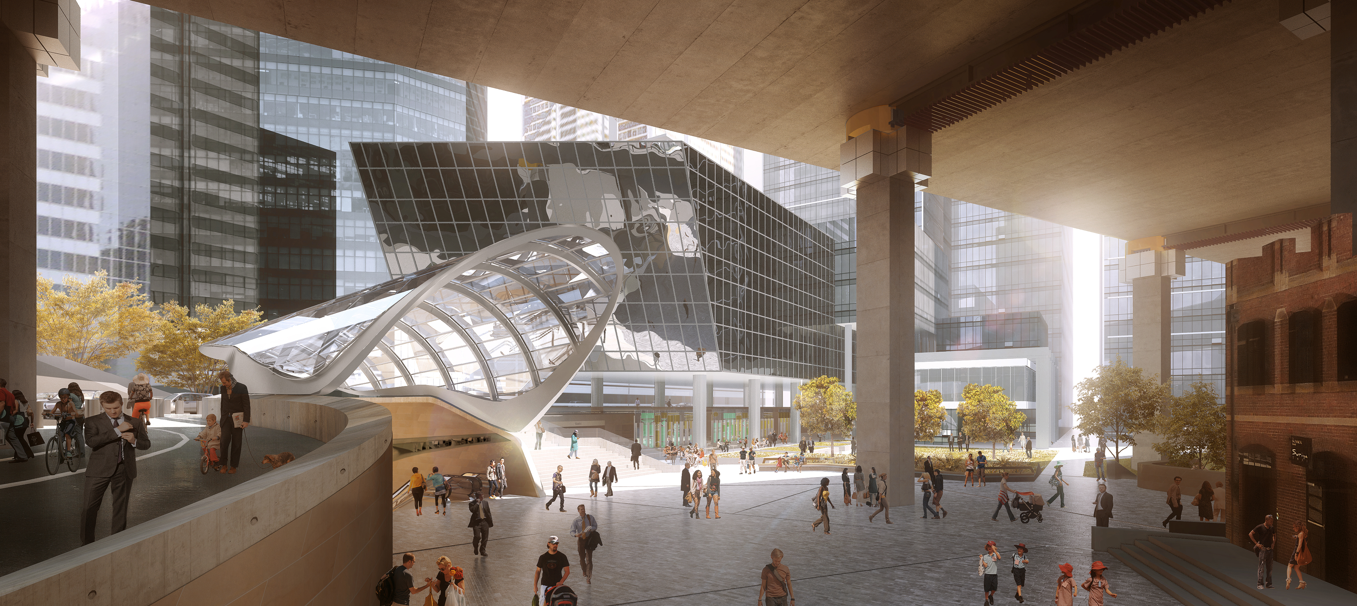
Infrastructure & Services
Industry Briefing
6 September 2016

Slide 2

Welcome
Simone Blakeman

Slide 3
The Hon Andrew Constance MP
Minister for Transport and Infrastructure

Slide 4
Tim Reardon
Secretary
Transport for NSW

Slide 5
Clare Gardiner-Barnes
Deputy Secretary
Transport for NSW

Slide 6
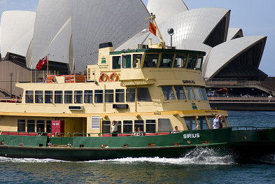

Key Projects
Circular Quay
XPT Replacement

Slide 7
Industry Engagement with Technology
Capturing the best technology solutions
Cooperative Intelligent Transport Initiative
Premier’s Innovation Initiative: Codha Wireless
Smart Innovation Centre

Slide 8
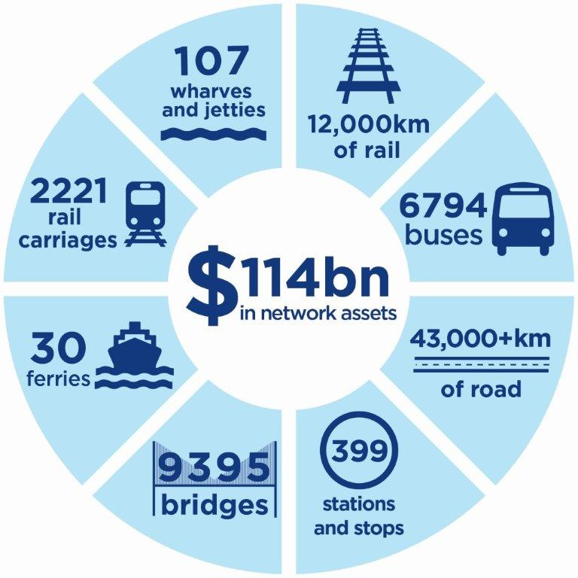
ASA progress
Industry engagement – building communities of practice
Assuring all modes - for safety and asset assurance
Surveillance of AEOs - working to assure delivery quality and safety
Light Rail and Maritime standards
RMS alignment
Social Procurement Workforce Policy development

Slide 9
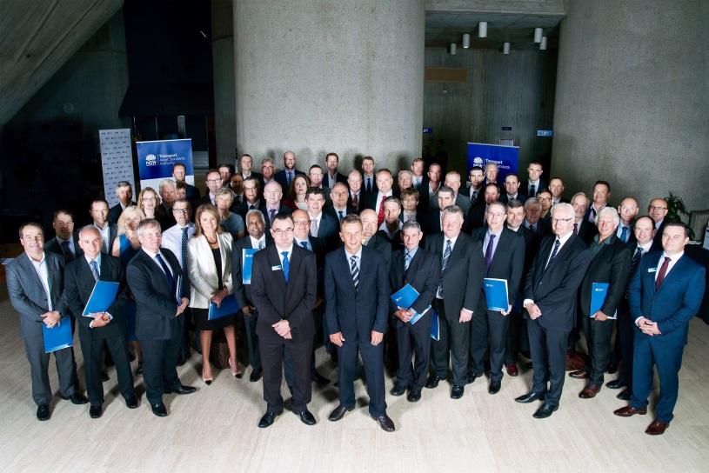

AEO community

Slide 10

TOWARDS ZERO
HOW CAN INDUSTRY GET INVOLVED?

Slide 11
Craig Moody
Manager, Major Project Services
Ausgrid

Slide 12

Transport for NSW
Infrastructure and Services
Industry Briefing
6th September 2016
Craig Moody
Manager – Major Project Services

Slide 13
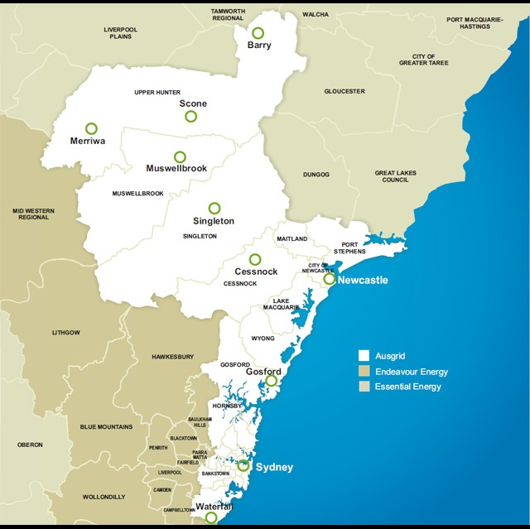
About Ausgrid
Distribution network covering 22,275 sq. km
Sydney, Newcastle, Central Coast, Port Stephens and Hunter Valley
More than 1.7 million customers including the Sydney CBD.

Slide 14
About Ausgrid
Priorities
Maintain supply to customers
Safety throughout the asset lifecycle
Reliability of the network including ratings and ability to augment the network in the future
Access to operate and maintain the network
No increase to ongoing operation, maintenance and augmentation costs

Slide 15
About Ausgrid
Challenges
  Increased economic and construction activity in the Ausgrid area
  Contestable connection requests at a high level for residential and commercial development projects.
  Unprecedented volume of work on Major Infrastructure Projects
  The Ausgrid regulated business undergoing transformation in line with AER funding determinations.
  Resource constrained through increased demands and transformation
Considerations
  Impacts and clashes of new infrastructure on existing assets
  Network augmentation for construction and permanent power supplies
  Complexity and timeframes escalate and market capability decreases as voltages increase

Slide 16
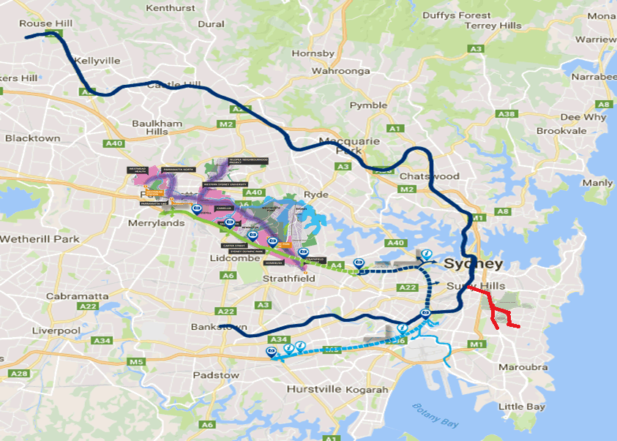
Working with Transport for New South Wales
Ausgrid involved in:
  CBD and Sydney East Light Rail
  NorthConnex
  WestConnex 1, 2, & 3
  WestConnex RMS Enabling works
  Sydney Metro – Northwest and City & Southwest
  Parramatta Light Rail
  B-Line Northern Beaches
  Newcastle Light Rail
  Northern Beaches Hospital
  Mona Vale Rd Upgrade
  Etc, etc

Slide 17
Working with Transport for New South Wales
Ausgrid working to assist TfNSW on the successful delivery of their projects through;
  Early engagement that:
    Provides expert advice on design options and impacts on Ausgrid assets
    Establishes communication channels between the project and Ausgrid
  Identifying potential points of electricity supply to assist project design
  Agreement on high level principles of asset treatments, prioritised for Ausgrid as:
    Retain and protect
    Modify
    Relocate

Slide 18
Areas that have worked well
Early engagement at agency level
Collaboration during design phase and identify issues
Participation in the safety in design process
Ausgrid input into construction methodology
Co-ordination of Ausgrid capital works with the projects
  Value engineering to facilitate ‘best-for-project’ outcomes
  Work collaboratively to share knowledge and resolve issues

Slide 19
Areas for improvement
Programs and schedules that provide early warning of impacts on Ausgrid assets and connection requirements
Project proponents to lead coordination of the various parties on the project – design, construction and ASP’s
Safety awareness when working around Ausgrid assets – working near electrical infrastructure protocols
Quality of designs – a focus on getting it right the first time to minimise rework that impacts project programs and costs
Project planning that acknowledges resource constraints of key resources and required timeframes for contestable works

Slide 20
Working with Transport for New South Wales
Ausgrid has established a dedicated Infrastructure Project team focused on major infrastructure projects;
  Based on project complexity and impact on Ausgrid assets
  Early engagement directly with the respective project agency
MoU or Deed established specific to the project
Commercial & Delivery Options:
  Standard contestable (NECF) framework
  Recoverable works contracts
  Consultancy services

Slide 21
Summary
Agencies seek to engage early
Develop an umbrella agreement
Work collaboratively
Recognise each other’s drivers and constraints

Slide 22
Paul Higham
General Manager, Liveable City Solutions
Sydney Water

Slide 23
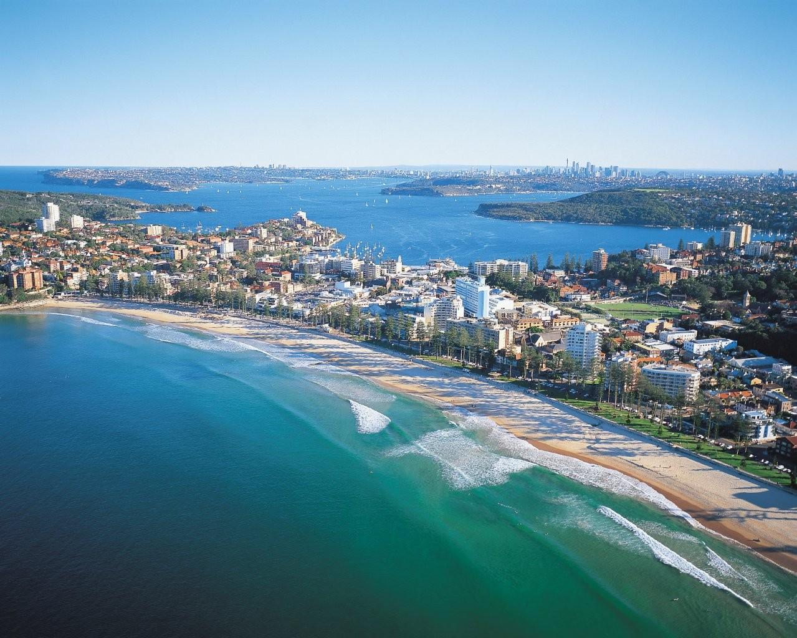
Working with you to deliver
Paul Higham
A/Manager Liveable City Solutions

Slide 24
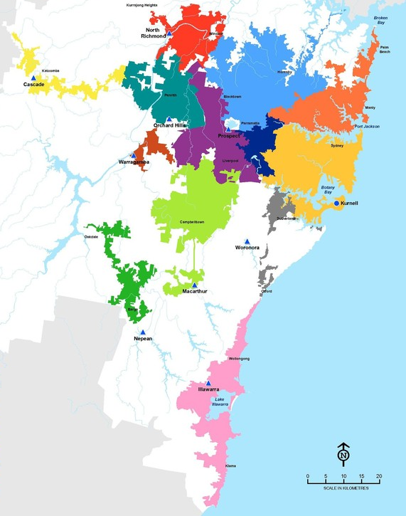

Scale of our current assets
Area of operations
Water Supply
9 Water Filtration Plants
1 Desalination Plant
1.4 Billion Litres / day
21,000 Km of pipes
251 Reservoirs
164 Water pumping stations
Wastewater
30 wastewater catchments
24,000 km of pipes
16 Waste Water Treatment Plants
680 Pumping Stations
13 RWTP
Stormwater
20% of Sydney’s urban area
525,000 properties
30 councils
442 km trunk mains
70 SQIDs

Slide 25
Sydney Water Assets & Development
We are currently managing >600 development cases that impact Sydney Water assets
43% of the current cases relate to Transport for NSW rail projects
An additional 20% relate to Roads and Maritime Services projects
Transport For NSW is a critical Development Partner
We are working to explore options to keep our assets safe, meet our operating licence and progress development
Build Over Asset
Protect Asset
Adjust Asset
New Works

Slide 26

Working together
Transport for NSW
Project Team
Liveable City Solutions
Development Partnerships
Principal Contractor
Utility Designer
Utility Adjustment Contractors
Water Servicing Coordinator
Agents for Sydney Water
We recognise that complex infrastructure projects require increased involvement from Sydney Water
Contact
Renee Ingram
Manager Development Partnerships
Renee.Ingram@sydneywater.com.au

Slide 27
Project Delivery Partners
Project Phases
Sydney Water Input
Concept Development
Early advice on our assets
Identifying constraints, risks and opportunities
Alignment with our planning and other projects
Design
Establish requirements, resolve issues, identify solutions
Water Isolation & Management Plans
Construction
Provide support to resolving new issues
Shut down, divert water, disinfect before start up
Operations
Assist through project completion and handover
Accept new asset handover for operations
Early engagement allows Sydney Water to work with you to deliver

Slide 28

How can we work more efficiently together?
Early Concept Stage Engagement
Provides visibility so that the project impacts on Sydney Water infrastructure are understood, and the opportunities and risks are considered
Enables collaboration across government projects to delivery cost efficient outcomes
Early provision of project plans assists us to better resource, plan and collaborate
Collaborative planning enables us to provide timely outcomes to meet project priorities
Reaching agreement with Transport for New South Wales will ensure there is an alignment on responsibilities and a shared vision for the project
Project Specific requirements can be detailed in specific commercial arrangements tailored to specific projects
Collaborative Project Planning
Interface Agreements

Slide 29
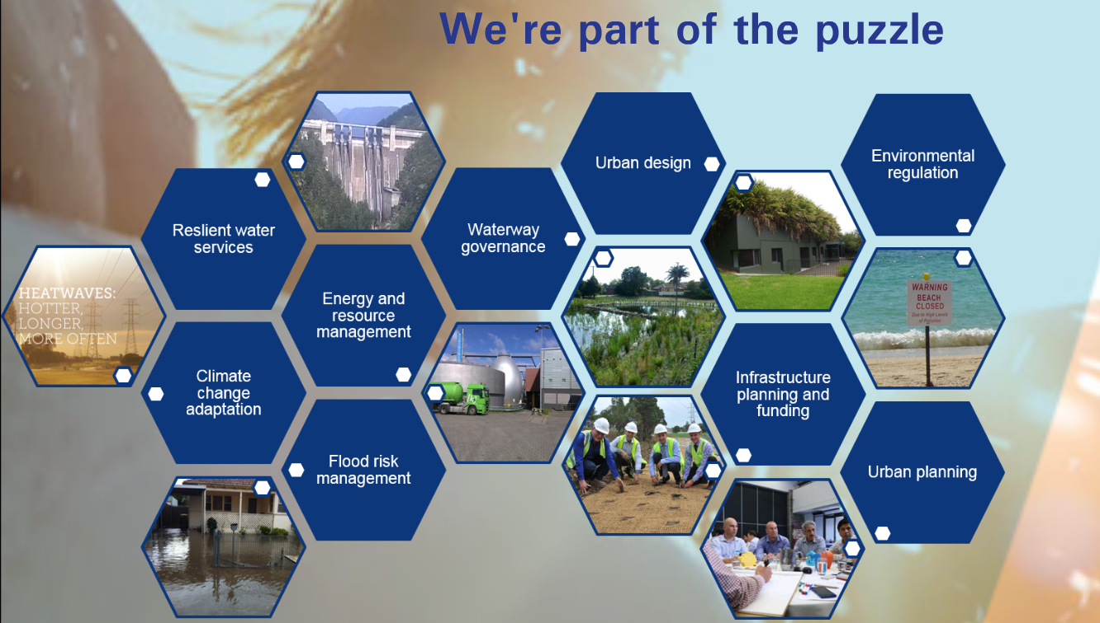


Slide 30
Working with you to deliver

Slide 31
Q and A with Panel:
Tim Reardon (Transport for NSW)
Clare Gardiner-Barnes (Transport for NSW)
Craig Moody (Ausgrid)
Paul Higham (Sydney Water)

