Slide 1

Infrastructure and Services
Pipeline of Projects

Slide 2
Louise Sureda
Director, Planning & Environment Services
Service, Planning and Development
Transport for NSW

Slide 3
Service Planning & Development
Service and asset planning for:
  Light rail, bus and ferry networks
  Multi-modal initiatives
Infrastructure & Services Value Chain
  Manage Engagement at Concept Stage
  Lead concept development stage
  Program oversight across life-cycle

Slide 4
Service Planning & Development
Projects
  Parramatta Light Rail
  Transport Access Program
  Bus Priority Improvement Program
  Parramatta River initiatives
Services
  Northern Beaches B-Line Project
  South eastern Sydney bus network
  Integrated service plan for North West Sydney
  Service plan for the fleet of new Inner Harbour ferries
  Growth Services Program

Slide 5
Wes Heron
Executive Director, Program Delivery
Transport for NSW

Slide 6
Program Delivery
Fleet | Newcastle Light Rail | Northern Beaches B-Line | Power Supply Upgrade | Precincts & Infrastructure | Rail Infrastructure
Key focus areas
Safety
Relationship with contractors and suppliers
Compliance with Standards & relevant legislation
Innovation and smart infrastructure
Delivering Value – the customer is at the centre of everything we do
On time & on Budget
Key Challenges:
Legacy infrastructure – over 100 years old
Staging complexity due to existing infrastructure and rail operations
Workforce shortage of skills

Slide 7
Fleet
New Intercity Fleet (NIF)
Video shown during the presentation, can be viewed here:
https://www.youtube.com/watch?v=NIjy9oGj4q0

Slide 8
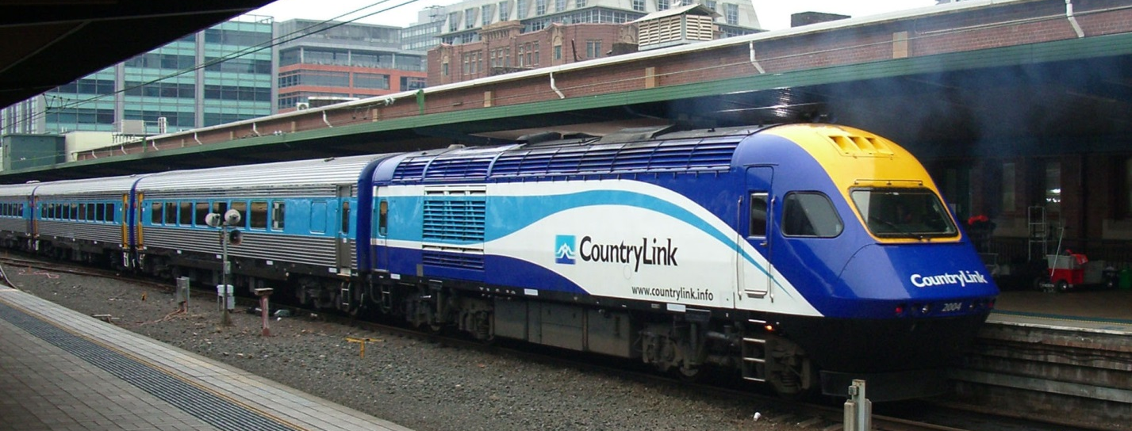
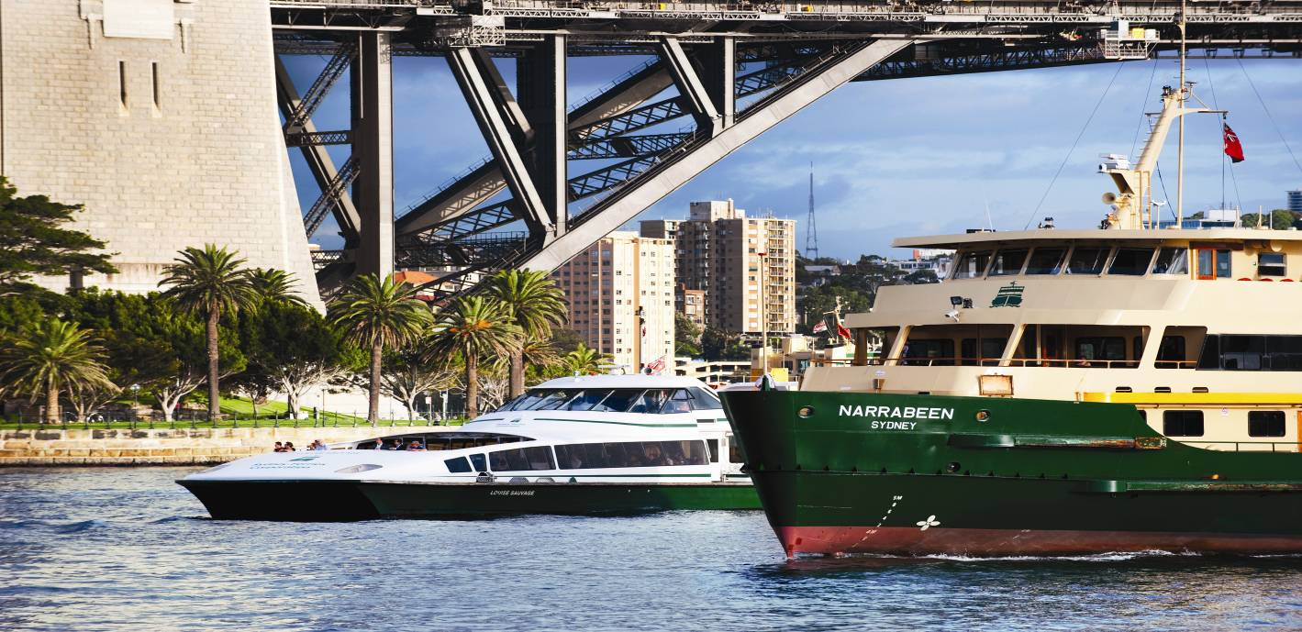
Fleet
XPT regional fleet
Parramatta River Ferries

Slide 9
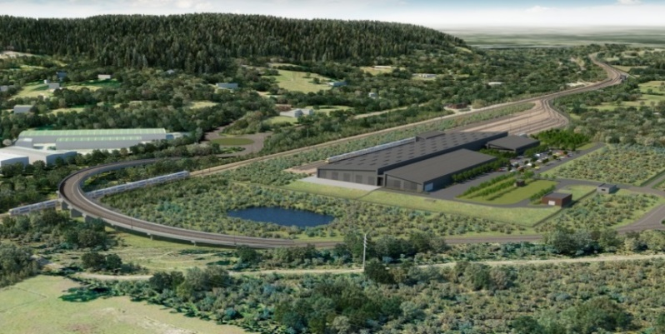
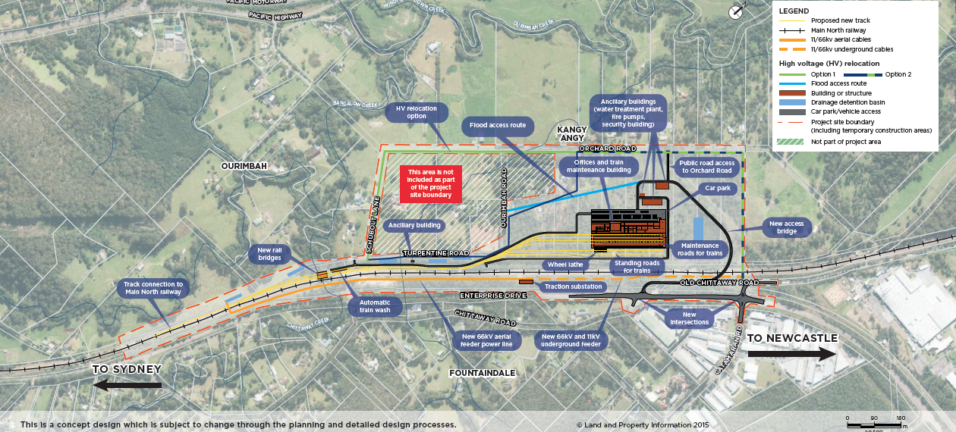
New Intercity Fleet Maintenance Facility
Key Dates
REF – to be determined | Sep 2016
Tender invite | Sep/Oct 2016
Construction | Jan 2017
Artist’s impression, subject to detailed design

Slide 10
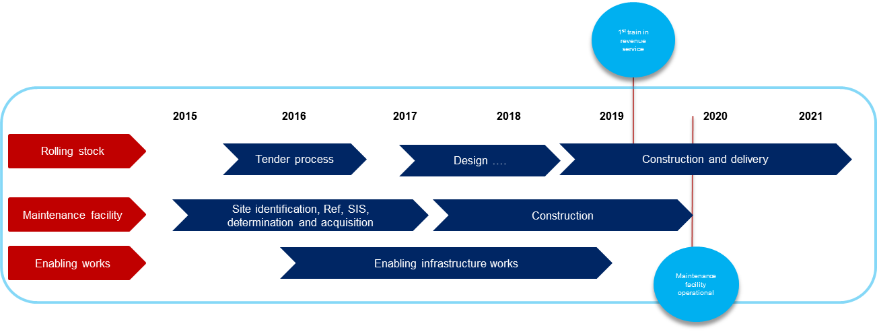
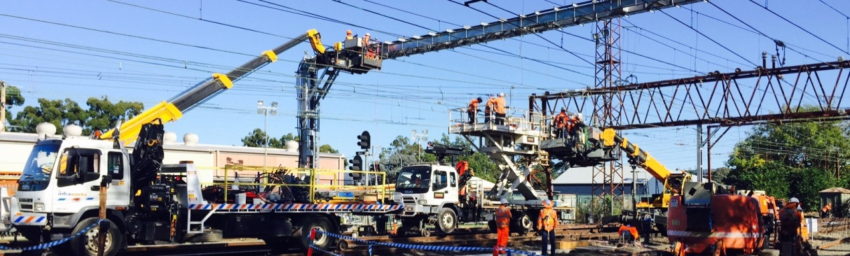
NIF Infrastructure Enabling works

Slide 11
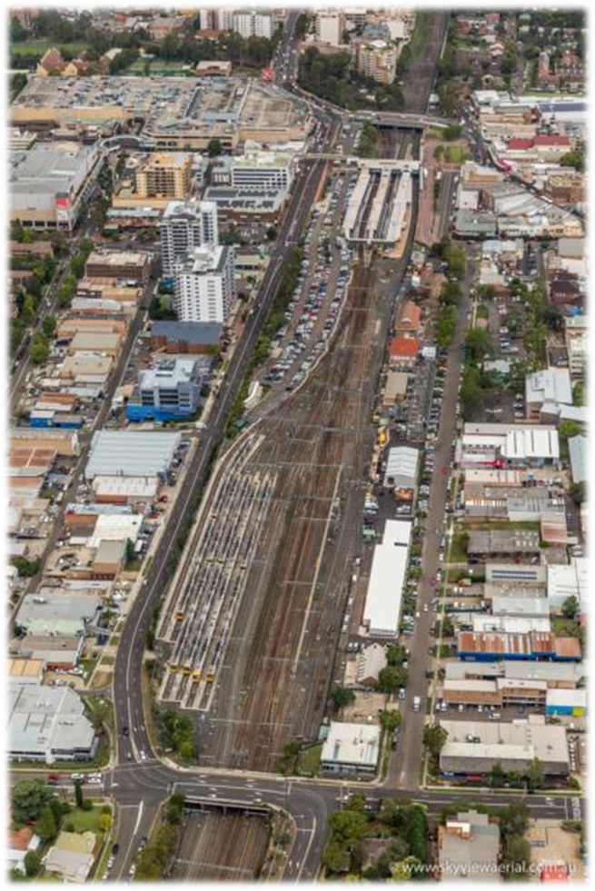
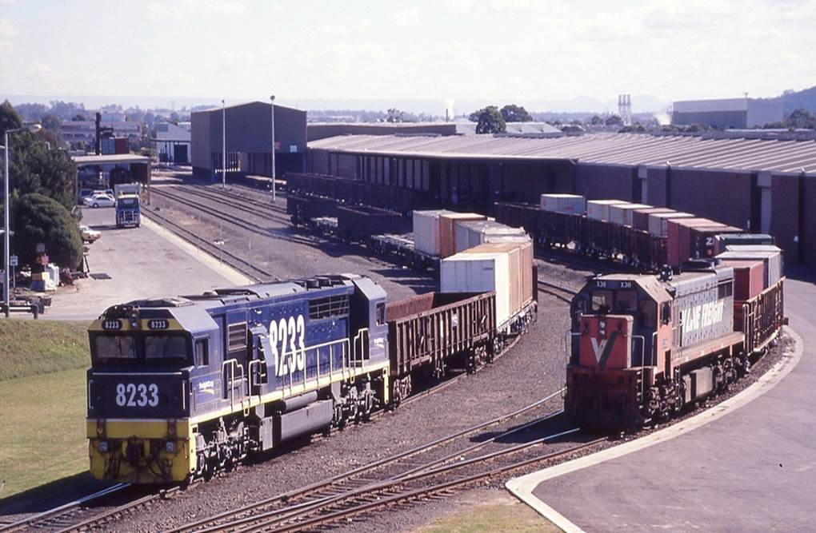
Rail Infrastructure works
Hornsby Junction Remodelling
Key projects
Hornsby Junction remodelling
Blacktown High Speed Crossover
Yennora siding access improvements
Tenders:
Construction tenders for Blacktown and Yennora were issued on 22 August
Close 2pm Tuesday 4 October, 2016
Yennora siding

Slide 12
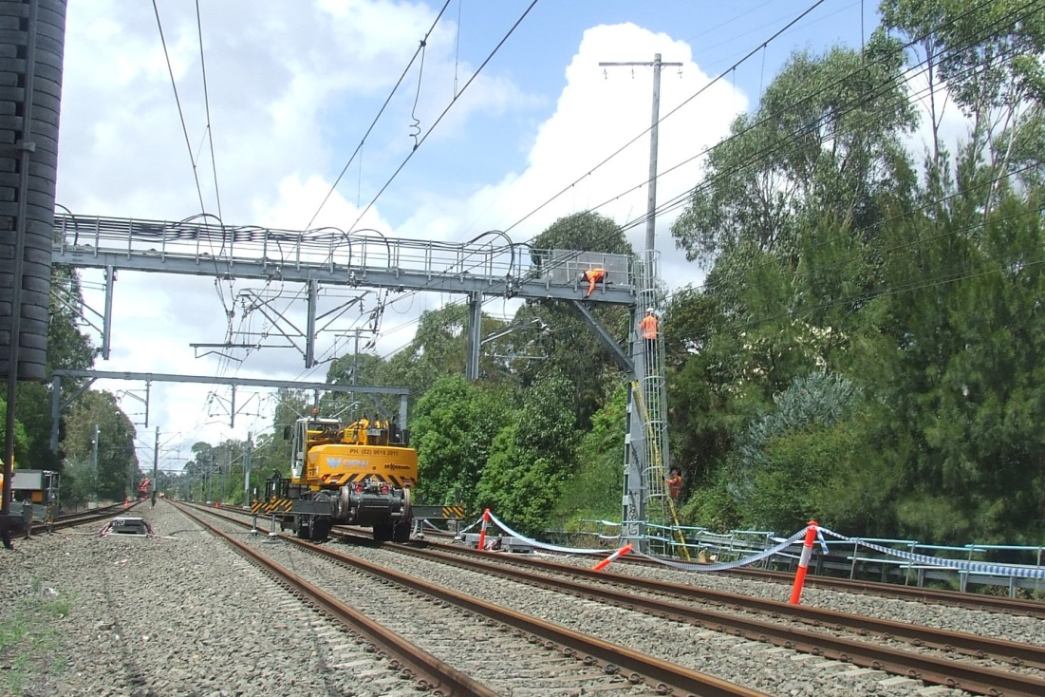
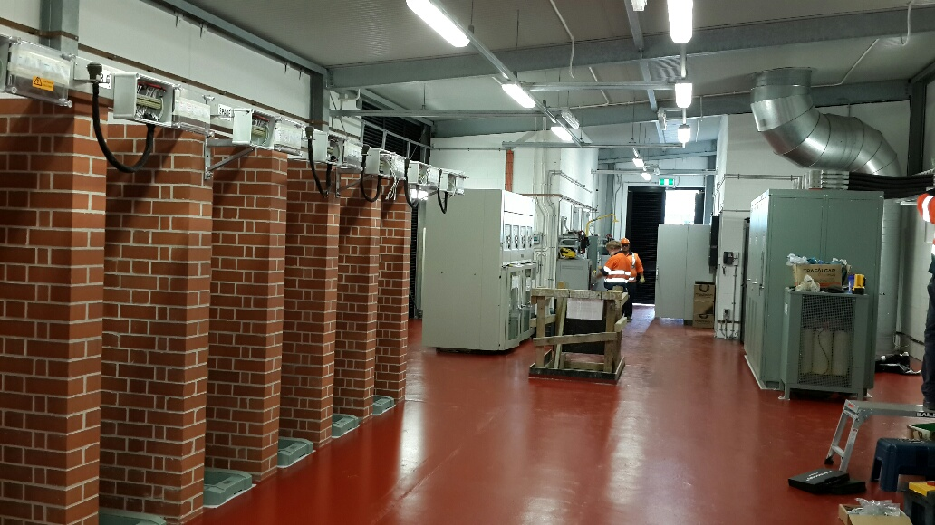
Power Supply Upgrade
Key program features:
Large geographical area – Lithgow, Newcastle, Kiama, Macarthur
NIF Enabling works
Dependant on critical rail-specific electrical resources
Small critical resource pool to draw on
Dependant on track access for brownfield build and commissioning activities
Financial commitment to date $1.168bn

Slide 13
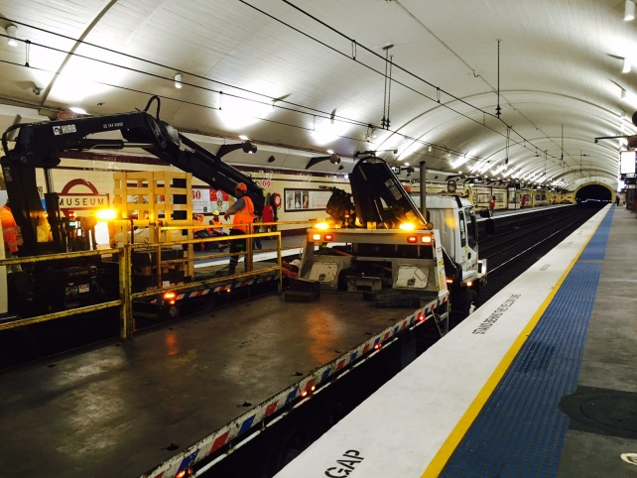
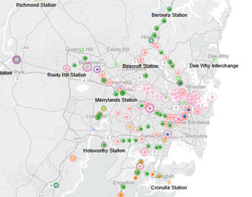
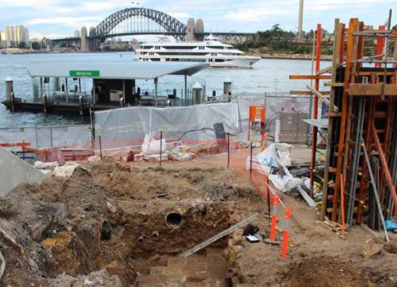
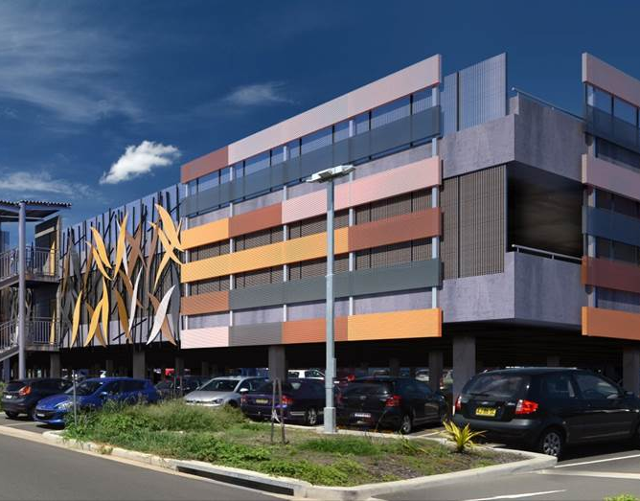
Precincts & Infrastructure
Transport Access Program

Slide 14
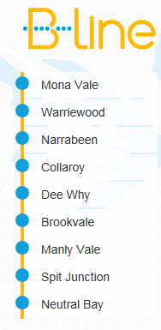
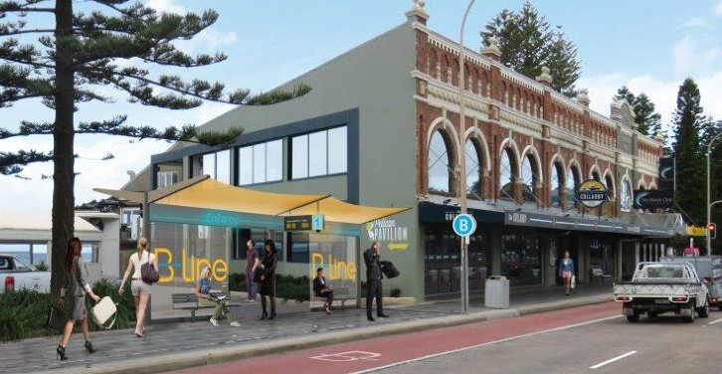
Northern Beaches Bus-Line
Program Includes:
Nine B-Line stops
Six new commuter car parks at Mona Vale, Warriewood, Narrabeen, Dee Why, Brookvale and Manly Vale
Brand new double decker buses
Roadworks: new bus lanes, bus bays, minor lane widening
Improved pedestrian and bicycle links
Design and construction tender
Stage of Delivery | Date
Issue Invitation to Tender to Shortlisted Applicants | Aug 2016
Tender Lodgement | Sept 2016
Award of Contract | Sept 2016
Anticipated completion of works Portion 1 Portion 2 | Oct 2017 Dec 2018
Anticipated completion of works for Portions 1 & 2 | Dec 2018

Slide 15
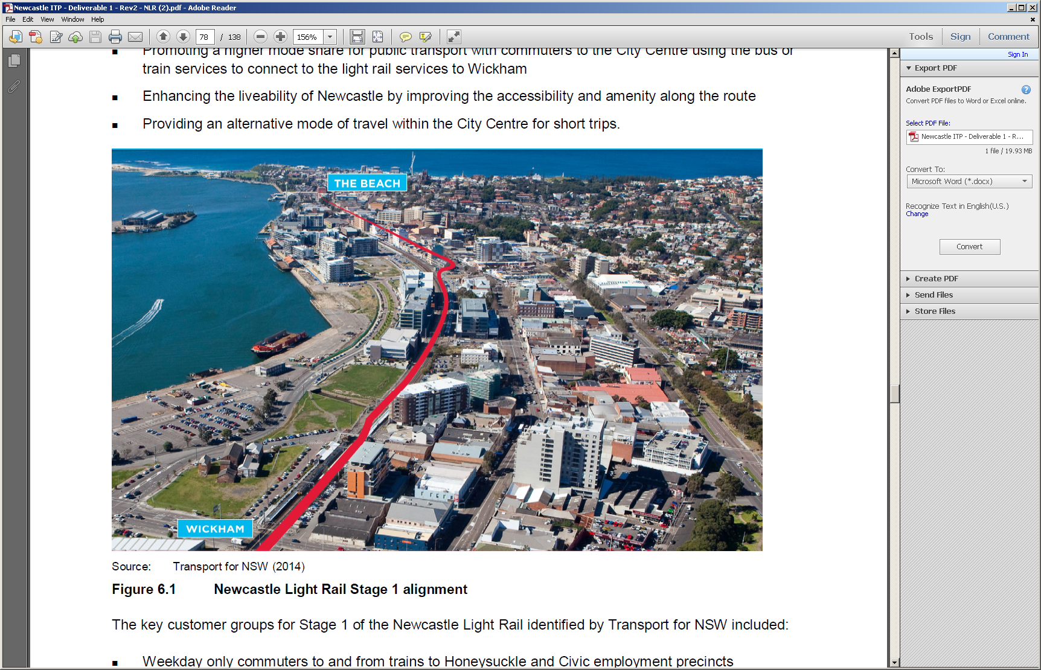
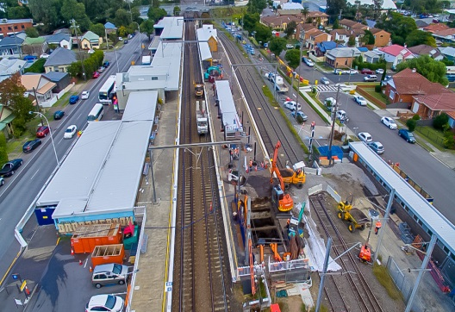
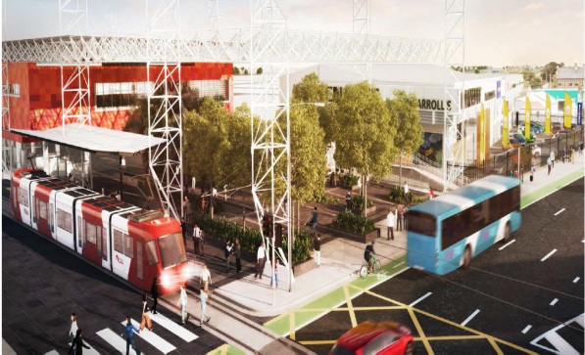
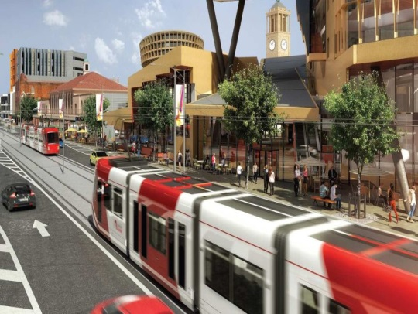
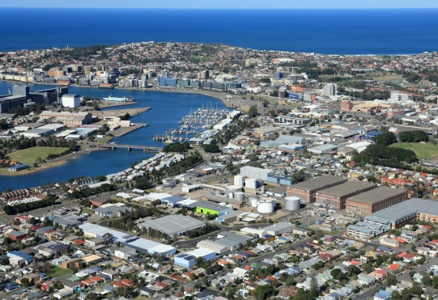
Newcastle Light Rail
Program Includes:
rehabilitation and removal of the heavy rail corridor
Wickham Transport Interchange
Broadmeadow Station Upgrade
2.7 kilometres of light rail track in Newcastle
six light rail stops
a stabling and maintenance facility
road works and associated precinct works

Slide 16
Pascal Labouze
Executive Director, Operational Systems
Transport for NSW

Slide 17

Operational Systems
Delivering technology to keep NSW safe, informed and moving
Plan, Deliver and Manage smart technology solutions for safe and efficient transport services:
  Rail systems (On-board and Trackside assets)
  Provide real-time and analytical data solutions for all modes of transports
  Develop and support multi-modal proactive management system
Integrate technology systems across Transport for NSW
Operational Systems
Rail Systems
Development
Automatic Train Protection (ATP)
Transport Management Centre Systems Development
Bus, Ferry & Light Rail Systems Development
System Operations

Slide 18
ATP Automatic Train Protection
Program objectives
Address a key recommendation of the Special Commission of Inquiry into the Waterfall Rail Accident
Increase safety on the network by preventing trains from over-speeding and movement beyond a train’s authority.
Provide a migration path to a future ETCS Level 2 as envisaged in Sydney’s Rail Future.
Program Scope
Deliver the Advanced train control Migration System (AMS).
AMS incorporates European Train Control System (ETCS) technology and specifications and operates in conjunction with existing network infrastructure and signalling.
Deliver ATP to the electric fleets and across 100% of the network.

Slide 19
ATCS Advanced Train Control System
Program objectives
Increase capacity of 24tph and beyond with the existing double-deck fleet
Lower lifecycle costs than legacy systems
Improve safety, including for trackside workers
Improve service resilience, regulation and recover
Program Scope
Develop and implement ETCS Level 2 system over a pilot area
Indicative details only

Slide 20
Jenny Birch
Director, Metro
Service Delivery and Performance
Transport for NSW
Notes:
[Next slide: ]

Slide 21
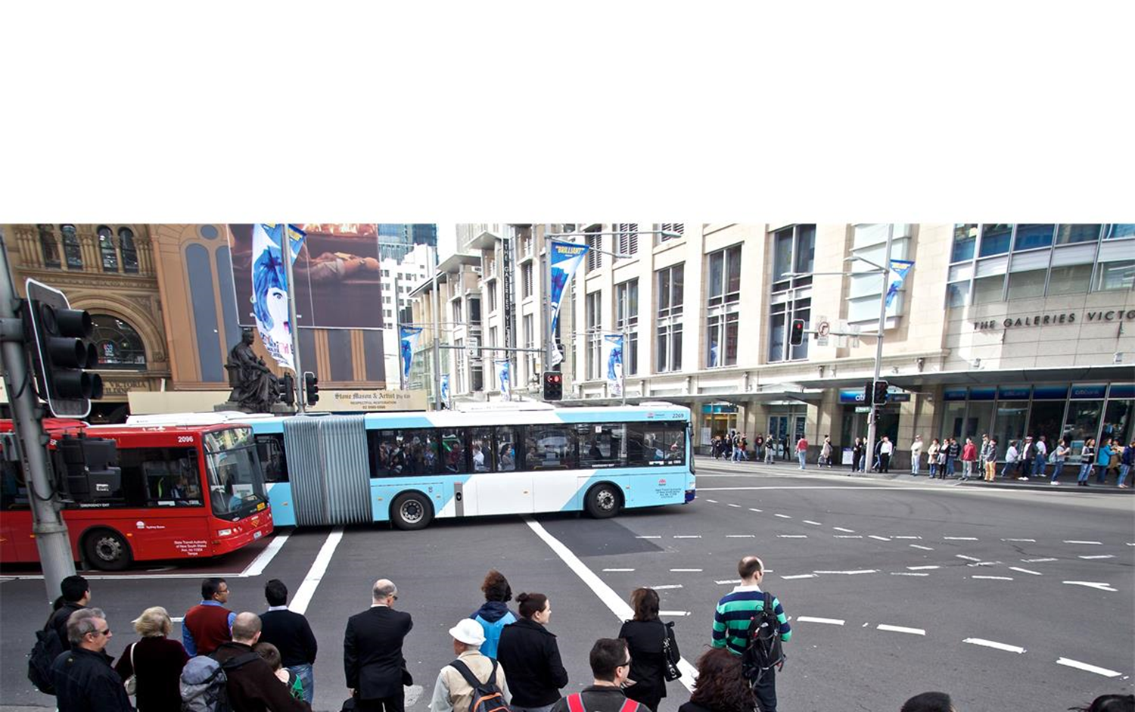
Service Delivery Pipeline

Slide 22
Service Delivery and Performance
Service delivery and performance (SD&P) is responsible for the management of service delivery, performance and service improvement outcomes of service and infrastructure operators including bus, ferry, heavy rail, light rail, and the Country Regional Network. In addition, the branch is responsible for the coordination of asset management, access standards management, revenue protection, security, and emergency management across the NSW transport network.

Slide 23
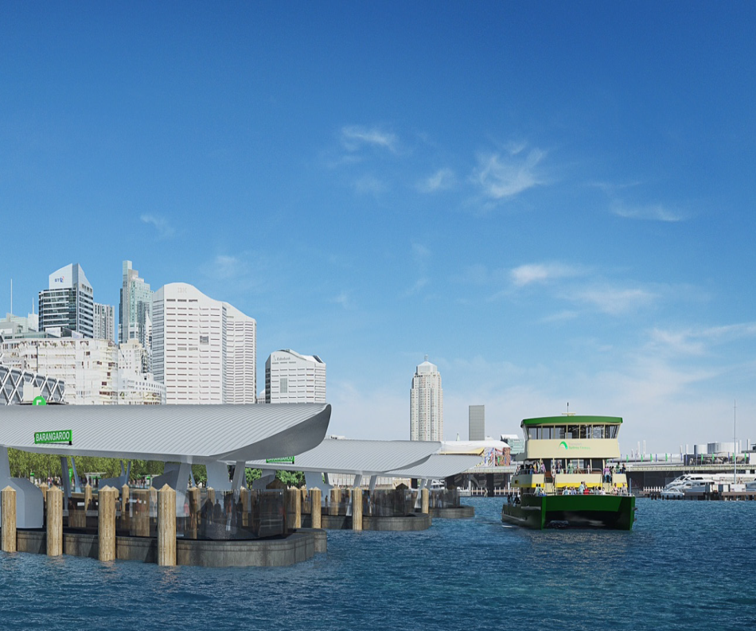
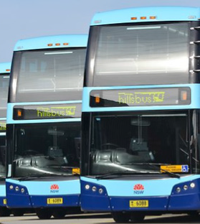
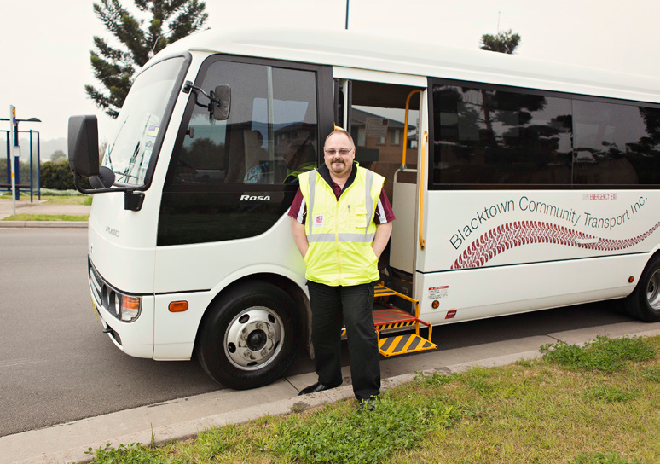
Service Delivery Pipeline
$50b
Over 10 years

Slide 24
Innovation
The environment we deliver services in is changing.
There has been an emergence of new transport technologies and a range of new transport service delivery business models.
  alternative fuel buses
  integrated service contracts
Better use of available transport data
Private sector engagement is critical

Slide 25
Q and A with
Infrastructure and Services

Slide 26
Wrap Up
Stephen Troughton
Deputy Secretary, Infrastructure and Services

Slide 27
Injury Type for the last 4 Quarters
Note that in all Injury Types the 4th Quarter 2016 has significant scale!

Slide 28
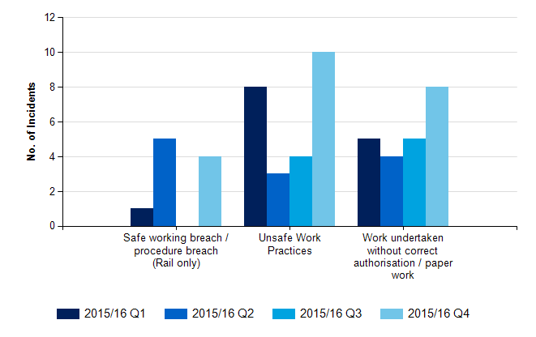
Unsafe Acts in the Last 4 Quarters
Note the Spike in Unsafe Work Practices and Work Undertaken without Correct Authorisation / Paper Work within the latest Quarter 4, 2016.

Slide 29
Wrap Up
Stephen Troughton
Deputy Secretary, Infrastructure and Services

Slide 30
Thank you for your attendance
For further information www.transport.nsw.gov.au

