Slide 1
Information taken from COVID-19 Infection control training for Health Care workers published by the Australian Government Department for health.

Slide 4
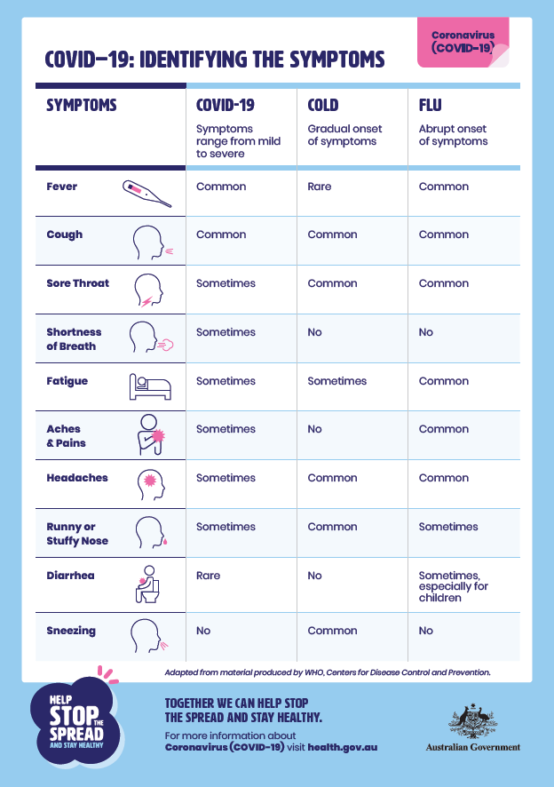

Slide 5
This information was based on information prior to 19 March 2020 and is changing daily as more information comes to hand.

Slide 11
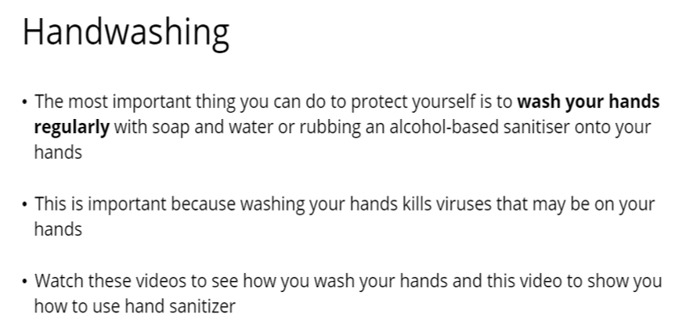
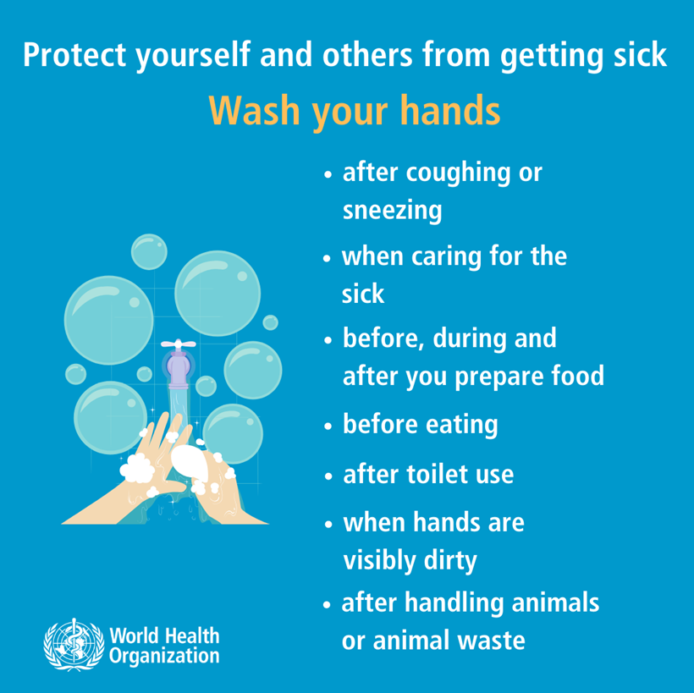
https://www.youtube.com/watch?v=ZnSjFr6J9HI
https://www.youtube.com/watch?v=3PmVJQUCm4E

Slide 13
Social distancing
•Maintain at least 1.5 metres distance between yourself and others.
•No more than 2 people at anyone time to gather/walk together unless direct family.
•Gatherings of people are now restricted- please refer to the following link
https://www.health.gov.au/news/health-alerts/novel-coronavirus-2019-ncov-health-alert/how-to-protect-yourself-and-others-from-coronavirus-covid-19/limits-on-public-gatherings-for-coronavirus-covid-19
If you are further away than 1.5 metres, it is very unlikely that you will breathe in droplets that might contain COVID-19

Slide 19
Managing Visitors
•Only essential visitors to be allowed access.
•Visitors at the workplace to sign declaration at front desk.
•Maintain Social Distancing rules.
•Decline hand shaking.

Slide 23
Key message for COVID-19
•Wash/sanitise hands regularly.
•Don’t Touch your face unnecessarily.
•Seek medical advice immediately when showing signs , however phone before attending as they will have a process you will need to follow.
•Inform your Manager/Supervisor of any symptoms.
•Follow Doctors and the Company directed requirements.
For further information and updated
https://www.health.gov.au/news/health-alerts/novel-coronavirus-2019-ncov-health-alert

