Slide 1
Stop the Spread
Protect yourself and others from Covid-19
Toolbox Talk for all John Holland employees and subcontractors
Notes:
COVID-19 is a virus that causes upper respiratory tract infection as well as cold and flu-like symptoms
It’s very contagious even when you show no symptoms – we haven’t built an immunity to it yet nor is there a vaccine.
It’s been declared a ‘pandemic’ because it has spread worldwide

Slide 2
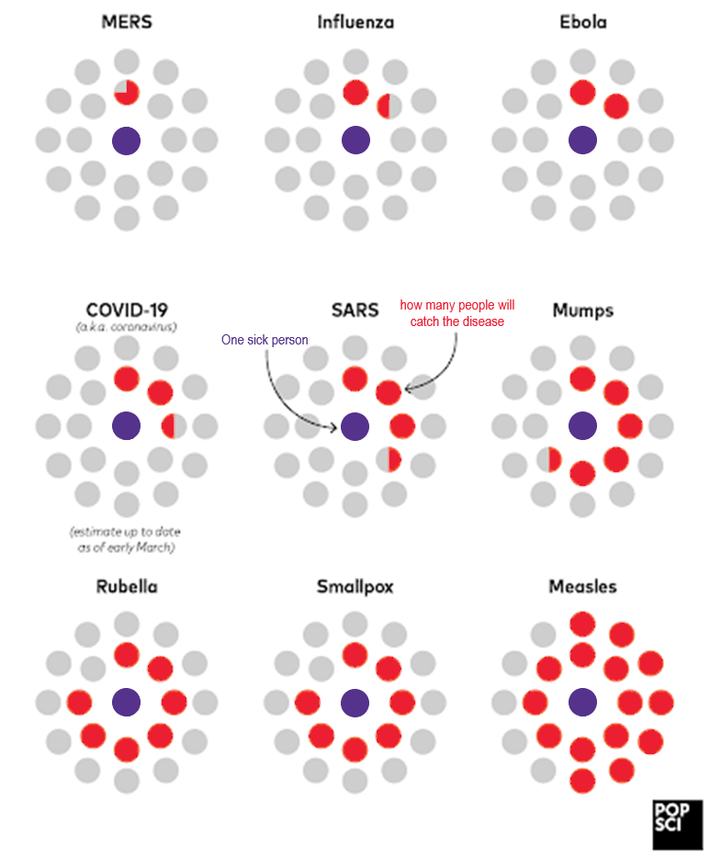
Why are there so many restrictions in place?
Someone can have the virus, and pass it onto others, and not know for up to 14 days.
One person may only experience minor symptoms, while a different person ends up in hospital or worse.
Perfectly healthy people have died from this virus. It does not discriminate.
We don’t yet have a vaccine or medication to stop people contracting COVID-19.
We can only rely on everyone doing the right thing to save lives.
Remember that this number may change as we learn more about COVID-19
Notes:
Though COVID-19 may not appear as contagious by nature as some viruses (based on the current findings), it is the 2-14 day incubation time teamed with the varying level of symptoms that make it particularly easy to spread when people don’t take it seriously.
A 2-14 day incubation time means that someone can have the virus, be able to pass it onto others, and not know for up to 14 days.
The varying level of symptoms means that:
A person may only experience such minor symptoms they may pass it off as hay fever
Another person may catch the virus and end up in hospital or worse.
Perfectly healthy people have died from this virus. It does not discriminate.
We don’t yet have a vaccine or medication to stop people from contracting COVID-19. We can only rely on everyone doing the right thing to save lives.

Slide 3
How can you stop the spread?
Notes:
There are some really simple ways we can stop this virus from spreading to you and from spreading to others. If we stop it spreading, we essentially kill COVID-19.

Slide 4
Stop the spread
1. Wash your hands – thoroughly!
One of the simplest ways to protect ourselves and protect others is something we do every day anyway, but we need to do it better.
Increase the frequency and pay attention to when you are washing or sanitising your hands.
Do it before and after eating, drinking or touching your face
Wash your hands after using the bathroom
Spend twenty seconds soaping and rinsing
Washing before protects ourselves
Washing after protects others
Notes:
This message has been repeated again and again.
This is because it’s one of the simplest ways to protect ourselves and protect others and it’s something we should all be doing normally anyway.
We need to increase our frequency and pay attention to when we are washing or sanitising our hands.
Ensure you do it before and after eating, drinking or touching your face in any way.
Wash your hands after using the bathroom with soap and water – scrub for at least twenty seconds
Washing before our hands go near our mouth, nose, eyes or food protects ourselves.
Washing after touching our face or potentially contaminated objects protects others.

Slide 5
Stop the spread
2. Sneeze or cough into your elbow
Our hands can easily infect surfaces and things others may also touch.
When using the crook of your elbow, ensure your nose and mouth are both covered.
If you fail to sneeze into your elbow, wash or sanitise your hands immediately before touching anything else.
Notes:
This may seem strange after a lifetime of being told to cover your mouth with your hand but it is necessary.
We touch so many things with our hands – keyboards, pens, cups, table tops, chairs. If we sneeze or cough into our hand, that hand can then infect surfaces and things others may also touch.
When sneezing or coughing into the crook of your elbow, ensure your nose and mouth are both fully covered.
If for some reason you are unable to sneeze into your elbow, or forget to, make sure you wash or sanitise your hands immediately before touching anything else.

Slide 6
Stop the spread
3. Maintain social distancing
Social distancing means:
If you can stay at home, you must stay at home
If your role can be done remotely, you should do it
If you are not doing something essential, you should be at home.
When you are around others, keep at least 1.5 metres away from each other.
Wave instead of shaking hands or hugging.
Use technology wherever possible to avoid face-to- face meetings
This is not just for those experiencing symptoms. Everyone must be doing this.
1.5 metres
Notes:
Social distancing is what we all need to do to keep ourselves and others safe.
Social distancing means: If you can stay at home, you should be at home. If you are not at work, getting medical attention, grocery shopping, or doing exercise, you should be at home.
It also means that when you are around people, you are keeping at least 1.5 metres away from each other.
This means that a lot of social norms like shaking hands or hugging need to stop for now, and alternative ways of greeting need to be used, like waving.
As we are an essential service, we do have certain leniencies in order to do the work we need to do, but there should still never be more than 5 people, at 1.5 metres distance from each other, in an enclosed space (like a meeting room) at a time.
We should use technology instead of face-to-face meetings wherever possible.
Everyone must be doing this. This is not just for those experiencing symptoms. Everyone needs to be practicing social distancing to stop the spread.

Slide 7
Stop the spread
4. Social distancing is now law
Police are patrolling
On-the-spot fines given for car-pooling, gathering in groups outside a worksite or on a meal break and not following the 1.5 metre social distancing laws
Enjoying smoko or a coffee together is in our nature, but we need to stop for now
Don’t gather with more than one other person outside a construction site: before work, after work or on a break
Very strict laws apply in private life too, so know what’s what in our state and help stop the spread
1.5 metres
Even on breaks and outside site
Notes:
Police are issuing on-the-spot fines
It’s hard to go against our normal habits but we have to
No gathering with more than one other person outside a construction site. Before work, after work or on a break.
When two people are standing together outside, they must observe the 1.5 metre social distancing laws.
Not car-pool with more than one person to and from work unless you share an address. Please also be mindful of social distancing if using public transport
Very strict rules apply in your private life too, encourage you to check up on each state’s rules

Slide 8
Stop the spread
5. Enable a hygienic and safe workplace
Minimise touch points
Spread out chairs and tables to 1.5 metres apart
Increase cleaning frequency (minimum twice a day)
Provide ample hygiene supplies
Limit non-essential visitors
Provide flexible working where possible to minimise people at the workplace
Consider split or roster teams to stagger attendance at prestart and the office
1.5 metres
Notes:
It is also important that we keep our workplaces clean and set up in such a way that they enable us all to maintain social distancing and hygiene. Some key things we should ensure are done within every John Holland workplace are:
Keeping touch points minimal by doing such things as:
Keeping doors open
Removing food containers
Provide any tea, coffee and sugar in pre-packaged sachets
Enable social distancing in all areas of the workplace by:
Placing tables in crib/break rooms 1.5 metres apart with only one chair per table
Where tables can’t be moved, such as in meeting rooms or office desks – remove chairs and spread the remaining chairs out so they are at least 1.5 meters apart.
Minimising the number of workers in any one area at the same time.
Increase cleaning frequency (minimum twice a day) and follow the guidance provided by John Holland on what needs to be cleaned, when and what cleaning products appropriate.
Provide adequate hygiene supplies in all areas of the workplace including:
Hand sanitiser
Soap at all sinks
Tissues
Paper towels
Limit non-essential visitors to the workplace
Provide flexible working where possible to minimise the number of people at the workplace
Split or roster teams to stagger attendance at prestart and the office.

Slide 9
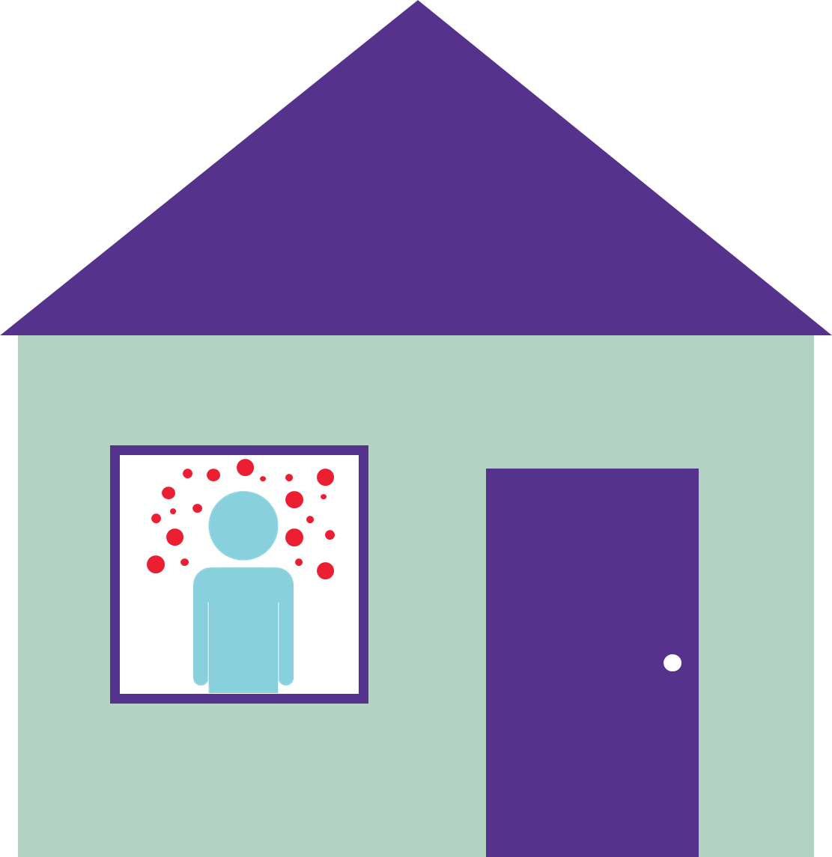
If you’re sick, stay home and isolate
If you are sick, go home and stay at home.
Call the doctor’s office before going in.
Have groceries delivered to your house.
Properly isolate for at least 14 days or until you have medical clearance.
If you test positive, ensure your manager at work knows as soon as possible so they can do what needs to be done
Contact others you may have been in contact with outside of work.
Notes:
If you are sick, go home and stay at home.
Call the doctors office before going in and follow their advice
Have a delivery service or a friend/family member drop food at your house.
Properly isolate for at least 14 days or until your have medical clearance. This means not going out for food, exercise, work or education. If you have family members or flatmates living with you, try to keep away from them also if possible, otherwise ensure the whole household is isolating.
If you test positive, ensure your manager at work knows as soon as possible so they can do a contact tracing immediately.
Also contact anyone you have come into contact with within the week before symptoms started showing.

Slide 10
Help each other
Talk to the Employee Assistance Program if you or your family are struggling with isolation
Try to switch off from the news if it’s getting you down
Connect with people in new ways – Zoom, FaceTime
Try healthy hobbies – a run, gardening, kick a soccer ball on the local oval (not in a group)
Stream TV series you enjoy
Find some good memes to make you laugh
Notes:
And finally, remember to help each other. We all in it together, and will get through it together.
The Employee assistance program is open to all John Holland Employees as well as their direct family members so call them up if you or your family are struggling with isolation
Try to switch off from the news if it’s getting you down. Maybe search for some good news instead like the good news network or the happy broadcast.
Connect with people in new ways – Zoom, FaceTime, Houseparty. There are so many different ways to connect out there
Try healthy hobbies – a run, gardening, kick a soccer ball on the local oval. Just be sure this isn’t done in a group to maintain the health and safety of yourself and those around you.
Stream TV series you enjoy.
Find some good memes to make you laugh and share them round to extend the laughter to others.

