Slide 1
COVID-19 Physical Distancing Guidance
COVID-19 Guidance Documentation
April 2020

Slide 2
NOTICE
The information in this pack is consistent with advice from the Australian Government and the New Zealand Government as at 03 April 2020.
In Australia, Government recommendations are for physical distancing of 1.5 metres.
In New Zealand, Government recommendations are for physical distancing of 2 metres.
Government advice and regulations regarding COVID-19 are changing often, sometimes within the course of a day.
If advice from these agencies in relation to this issue changes, or a relevant Government mandates further action in relation to the issues dealt with in this pack, Ventia will update the content to reflect that changed advice and/or mandated action.
Please continue to refer to theVine to ensure you have the most up to date information packs.

Slide 3
disclaimer
The following material has been developed by Ventia, one of TfNSW’s major contractors to support Ventia leaders in managing COVID-19 risks in their workplaces. The material has been developed taking account of advice from World Health Organization, Australian Government Department of Health, US Centre for Disease Control, and requirements of Australian and State Governments at the date noted in the packs.
Ventia has agreed to make the material available to TfNSW to inform and assist TfNSW in relation to the management of COVID-19 risks. Please note, however, that it has been developed to support Ventia’s specific context and may not be relevant to other organisations or in all TfNSW contexts. The reader will need to exercise judgement about the appropriateness of the Ventia materials and their relevance to the reader’s own requirements. Please note also that Government requirements regarding COVID-19 may continue to change, and the materials will need to be assessed against current government requirements.

Slide 4
How Does physical Distancing Work against Covid-19?
COVID-19 is most likely to spread from person to person when we come into close contact with one another.
Physical distancing is one way to help slow the spread of viruses such as COVID-19.
Physical distancing includes keeping a distance of 1.5 - 2 metres between you and other people whenever possible and minimising physical contact, such as shaking hands or sharing tools and equipment.
Physical distancing could also be reducing the amount of interaction between workers or work groups.
When physical distancing actions are combined with good personal hygiene measures the spread of the virus in the community can be slowed.

Slide 5
How Does physical Distancing Work against Covid-19?
Some physical distancing measures to be considered:
Wherever possible, attempt to keep a distance of 1.5 - 2 metres between people
Cancel non-essential meetings and gatherings at work
Hold essential meetings (such as toolboxes and pre-start sessions) outside in the open air or stagger starting times to smaller work groups or field teams
Stop physical contact, such as shaking hands as a greeting
Locate work crews in specific areas or locations, rather than across multiple locations
Consider changes to work spaces to provide physical distance (e.g. workers to relocate work spaces to increase physical distance, work crews located at multiple work fronts)
Eat lunch outdoors, at workstations or within work vehicles rather than use common areas shared by more people
Reduce movements of people wherever possible and for essential work activities only as determined by Supervisors and Managers
Implement control measures from the COVID-19 Travelling for Work Guidance

Slide 6
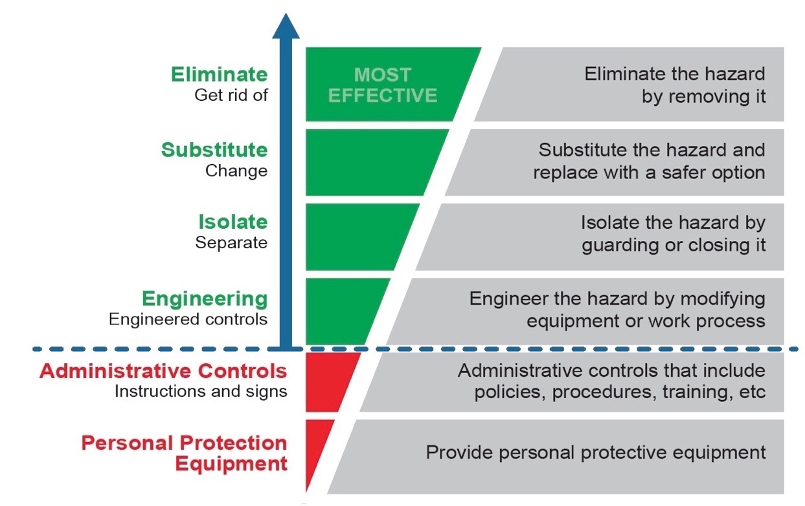
How Does physical Distancing Work against Covid-19?
Physical distancing can be very effective, but it is recognised that it cannot be practised in all situations without compromising other aspects of health and safety.
For specific tasks where physical distancing may not be practical to implement, each task must be consulted with affected workers and a risk-based approach undertaken, such as a SHEWMS or JSEA.
A hierarchy of control will be applied to consider the suitable controls for each task.
This may also consider:
Whether the area can be cleaned or disinfected prior
How often someone has worked within the area (e.g. infrequently accessed areas or shelters)
All risk assessments must be approved by the Supervisor or Workplace Manager prior to commencing the task.

Slide 7
Alternative Work Arrangements
Alternative working arrangements may provide suitable methods for physical distancing. Maintain flexible shifts – staggered start times to minimise interaction between work groups, encourage public transport use in off-peak periods.
Hold separate pre-starts/briefings – host multiple briefings/pre-starts to minimise interaction between work crews and maintain physical distancing of work groups
Consider multiple work hubs – some projects can make use of various work locations, rather than rely on a central location
Working from home - staff who are able to effectively work remotely (from home) can do so in consultation with their manager
Projects should always consider what is practical and the impact of arrangements on tasks in the field. It is critical that work tasks continue to have the right skills, tools, equipment and adequate supervision in place before commencing.

Slide 8
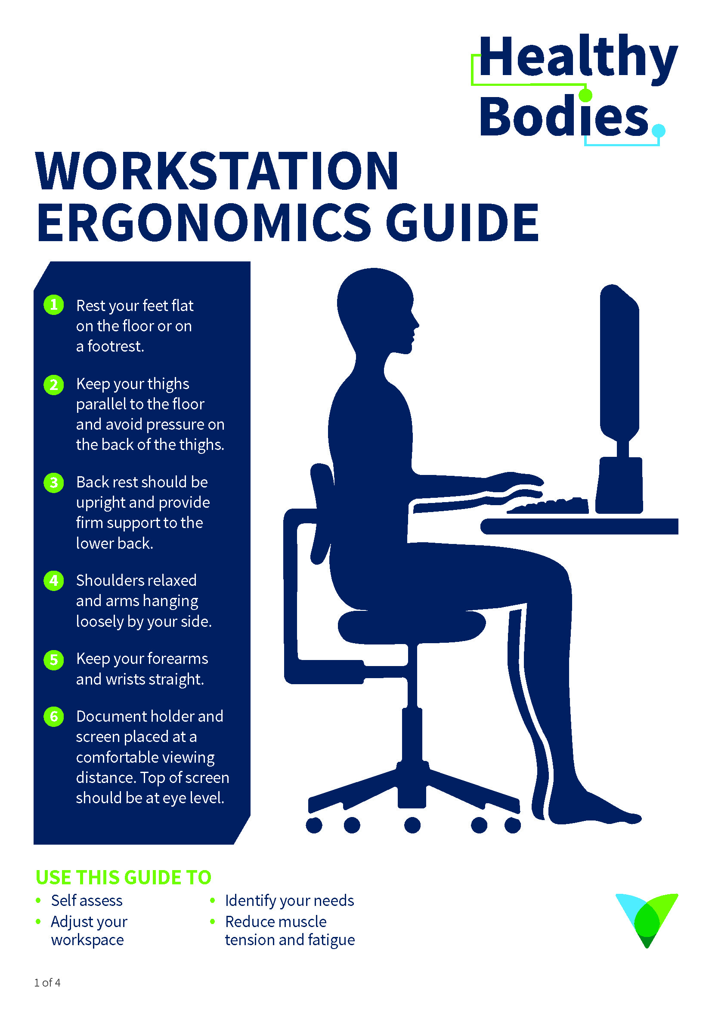
WORKING FROM HOME SAFETY GUIDANCE
Ensure that all workers working from home have completed the Ventia Working From Home Agreement in consultation with their manager
Managers and workers should ensure regular contact with all workers working remotely – this can be done by hosting teleconferences, holding regular wellbeing checks or other agreed measures
Workstation should be set up considering ergonomics principles
Resources for working from home are located on theVine

Slide 9
Key Takeaways
Physical distancing is an important defence to mitigate the spread of COVID-19
Physical distancing measures need to be consulted and risk-based to ensure suitability and approval for each project
Physical distancing measures can include physical separation between both workers and different work groups, as well as time based separation
Alternative work arrangements should continue to ensure that work tasks have the right skills, tools / equipment and supervision in place at all times

