Slide 1
Managing the impact of Coronavirus
TOOLBOX #1
MARCH 2020

Slide 2
disclaimer
The following material has been developed by Ventia, one of TfNSW’s major contractors to support Ventia leaders in managing COVID-19 risks in their workplaces. The material has been developed taking account of advice from World Health Organization, Australian Government Department of Health, US Centre for Disease Control, and requirements of Australian and State Governments at the date noted in the packs.
Ventia has agreed to make the material available to TfNSW to inform and assist TfNSW in relation to the management of COVID-19 risks. Please note, however, that it has been developed to support Ventia’s specific context and may not be relevant to other organisations or in all TfNSW contexts. The reader will need to exercise judgement about the appropriateness of the Ventia materials and their relevance to the reader’s own requirements. Please note also that Government requirements regarding COVID-19 may continue to change, and the materials will need to be assessed against current government requirements.

Slide 3
Covered in this toolbox
What we know about Coronavirus (COVID-19)
Supporting your welfare
What you should do if you have a suspected case of COVID-19

Slide 4
ABOUT coronavirus
Coronaviruses are a large family of viruses known to cause respiratory infections
These can range from the common cold to more serious diseases such as Severe Acute Respiratory Syndrome (SARS) and Middle East Respiratory Syndrome (MERS)
This new coronavirus originated in Hubei Province, China and the disease caused by the virus is named COVID-19
How is COVID-19 spread?
COVID-19 is most likely to spread from person-to-person through:
Direct close contact with a person while they are infectious or in the 24 hours before their symptoms appeared
Close contact with a person with a confirmed infection who coughs or sneezes
Touching objects or surfaces (such as door handles or tables) contaminated from a cough or sneeze from a person with a confirmed infection, and then touching your mouth or face
(This information is consistent with advice from World Health Organization, Australian Government Department of Health, and Ministry of Health New Zealand – this information may change over time)

Slide 5
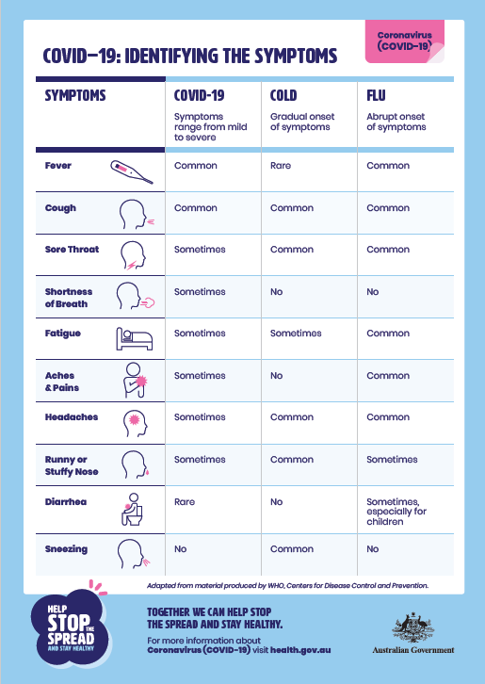
IDENTIFYING THE SYMPTOMS
COVID-19 symptoms (Australian Government Department of Health)
Visit www.health.gov.au for the most up to date information
Can range from mild illness to pneumonia. Some people will recover easily, and others may get very sick very quickly
Fever
Flu-like symptoms such as coughing, sore throat and fatigue
Shortness of breath
COVID-19 symptoms (Ministry of Health NZ)
Visit www.health.govt.nz for the most up to date information
A cough
A high temperature (at least 38⁰C)
Shortness of breath

Slide 6
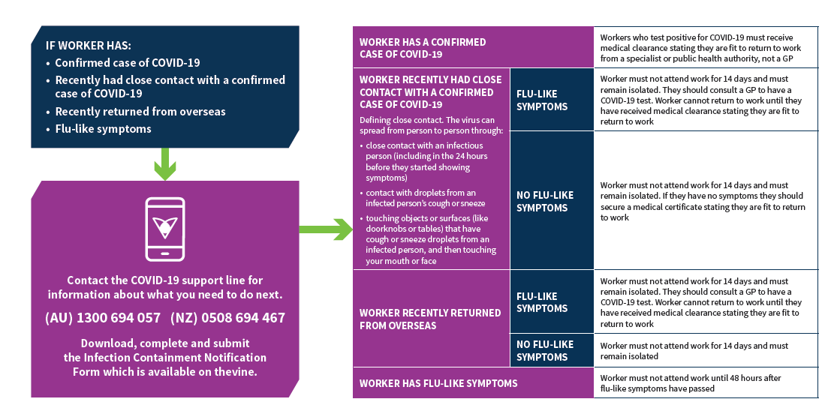
HOW WE ARE RESPONDING TO SUSPECTED INFECTIONS

Slide 7
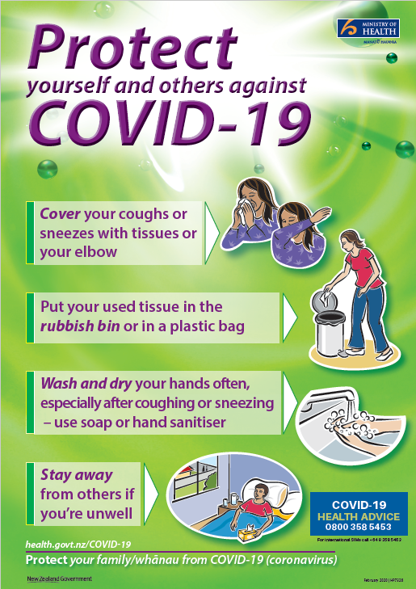
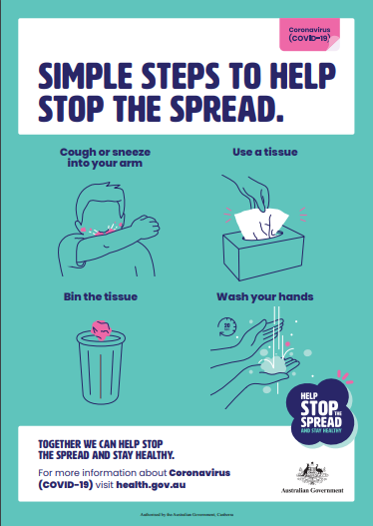
Supporting your welfare
Practicing physical distancing and good hygiene practice will help limit the spread of the virus. We ask that you:
Stop handshaking as a greeting
Practice good hand and sneeze/cough hygiene
Use hand sanitiser regularly
Increase the distance between yourself and others where possible
Hold meetings and training via video conferencing or phone call, or in an open well ventilated area
Avoid sharing food with others
If you feel unwell, suspect you may have been in contact with someone exposed to the virus, or are being directly tested, please get in touch with your Manager or Supervisor as soon as possible.
Source: Australian Government Department of Health

Slide 8
We’ve put in place a company-wide plan
This addresses how we:
Prevent the spread
Take precaution if there is a suspected case on one of our sites
Protect other workers if there is a confirmed case
Level 1 – Prevention No suspected or confirmed COVID-19 case(s) | Level 2 - Precaution Suspected COVID-19 case(s) | Level 3 - Protection Confirmed COVID-19 case(s)

Slide 9
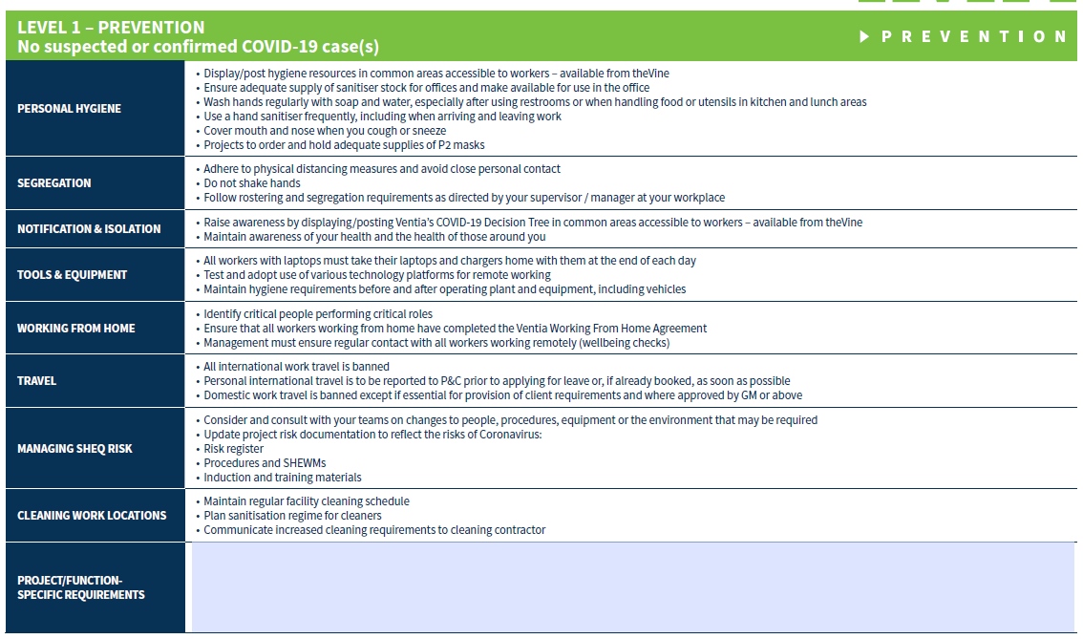
We are at level 1: prevention

Slide 10
MAINTAIN FOCUS ON SAFETY
It’s very important that we maintain focus on our safety fundamentals
Critical Risk Protocols
SHEWMS / JSAs / Take 5’s / START Cards
Providing good supervision
Looking out for new workers
Change during this period is inevitable. Many tasks we undertake require specialists skills – in the event that key workers are absent, ensure that appropriately skilled people are used for all tasks and that adequate supervision is provided. If you are concerned, talk to your supervisor.
Ensure you have appropriate levels of resourcing for your work – PPE, equipment, people
Projects will be incorporating new COVID-19 related safety requirements into SHEWMS, risk registers, induction, training etc

Slide 11
Counselling support is available
This is a period of uncertainty and change. If you or your family members are feeling anxious or depressed, help is at hand via our Employee Assistance Program provider, Assure Programs. Call for free and confidential support.
AUSTRALIA NEW ZEALAND
Phone 1800 808 374 0800 464 387
Text 0439 449 876 42 67

Slide 12
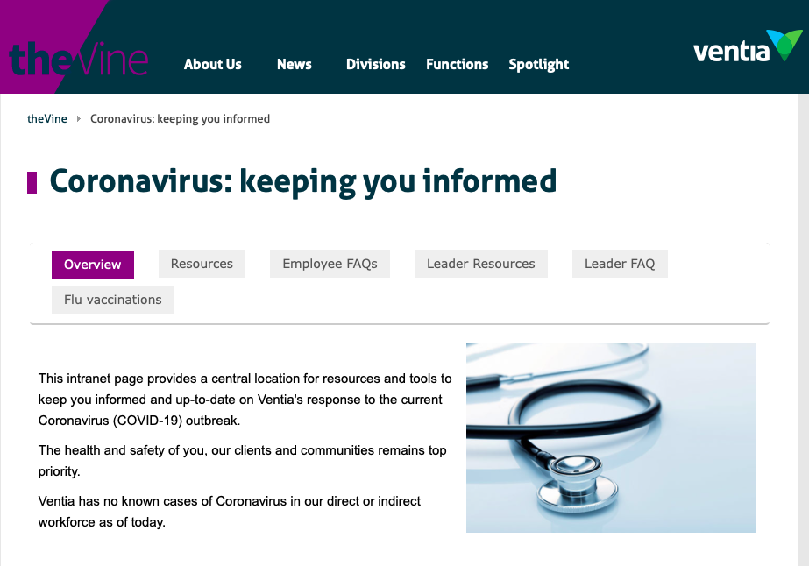
Where to get more information
A dedicated section of theVine has been created to provide our plans and instructions on the Coronavirus
You can also talk to your leader or P&C
Hygiene resources
Workplace posters
Government health advice
Mental health resources
Working from home information
FAQs
Flu vaccinations

Slide 13
Support numbers
We have a support line for managers and supervisors
The following government support numbers and websites are available for everyone’s use.
Further information is available on theVine
Australia – Coronavirus Health Information Line
Call Coronavirus Health Information Line if you are seeking information on coronavirus (COVID-19) in Australia. The number operates 24/7.
1800 020 080
www.health.gov.au
New Zealand – Coronavirus Health Information Line
Call Healthline if you are seeking information on coronavirus (COVID-19) in New Zealand. The number operates 24/7.
0800 358 5453
www.health.govt.nz

Slide 14
Key takeaways
With respect to infection containment, we are operating at Level 1 – Prevention
There is a Ventia process for reporting suspected and confirmed cases of COVID-19. Your leaders will know about any additional client requirements to notify.
Maintain focus on our safety fundamentals
Support is available for you and your leaders
Strategies are being put in place to minimise disruption for our large offices and key functions
Individual site plans are currently being developed – your local leadership will update you

