Slide 1
COVID-19 Use of Respiratory Protection Guidance
COVID-19 Guidance Documentation
March 2020

Slide 2
NOTICE
The information in this pack is consistent with advice from World Health Organization, Australian Government Department of Health, Ministry of Health New Zealand and US Centre for Disease Control, and requirements of Australian and State Governments, as at 25 March 2020.
However, Government advice and regulations regarding COVID-19 are changing often, sometimes within the course of a day.
If advice from these agencies in relation to this issue changes, or a relevant Government mandates further action in relation to the issues dealt with in this pack, Ventia will update the content to reflect that changed advice and/or mandated action.
Please continue to refer to theVine to ensure you have the most up to date information packs

Slide 3
disclaimer
The following material has been developed by Ventia, one of TfNSW’s major contractors to support Ventia leaders in managing COVID-19 risks in their workplaces. The material has been developed taking account of advice from World Health Organization, Australian Government Department of Health, US Centre for Disease Control, and requirements of Australian and State Governments at the date noted in the packs.
Ventia has agreed to make the material available to TfNSW to inform and assist TfNSW in relation to the management of COVID-19 risks. Please note, however, that it has been developed to support Ventia’s specific context and may not be relevant to other organisations or in all TfNSW contexts. The reader will need to exercise judgement about the appropriateness of the Ventia materials and their relevance to the reader’s own requirements. Please note also that Government requirements regarding COVID-19 may continue to change, and the materials will need to be assessed against current government requirements.

Slide 4
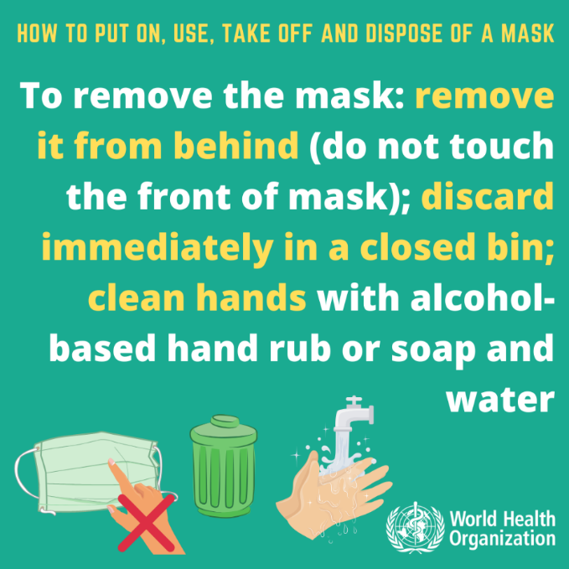
COVID-19 Use of Respirators
The COVID-19 virus is spread mainly from person-to-person in close contact with one another, through respiratory droplets produced when an infected person coughs or sneezes or by touching a surface or object that has the virus on it and then touching the face.
Practising physical distancing and good hand and sneeze/cough hygiene is the best defence against viruses.
Current health advice is that most people will not benefit from wearing a surgical mask or a respirator.
Masks are of benefit to people who are sick so they don’t cough on others, and health care workers who have frequent, close contact with sick people.
Even within clinical settings, P2 respirators are maintained for specialised procedures likely to generate aerosol from suspected COVID-19 persons.

Slide 5
Circumstances where we may use Masks/respirators
However, in specialised circumstances there may be times where the use of P2 respirators is implemented as appropriate protection.
These circumstances must be based on risk assessment and should consider all relevant risk factors.
Existing works that require use of a P2 respirators (such as asbestos works)
Sanitisation of workplaces or vehicles where a confirmed case of COVID-19 has been present (refer COVID-19 cleaning and disinfection guidance materials)
Where close contact with a confirmed or suspected case of COVID-19 may be necessary (such as certain examples of incident response)
If stock start to become low for P2 respirators, notify your supervisor or manager
Reusable respiratory protection (such as full face respirators) with P2 cartridges may be appropriate alternatives for tasks which will regularly need P2 respiratory protection and stock may be more readily available at these times.

Slide 6
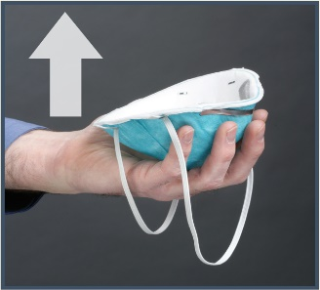
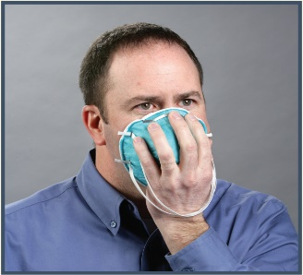
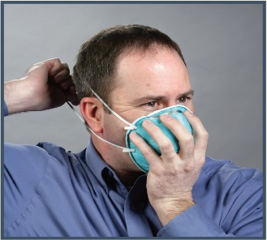
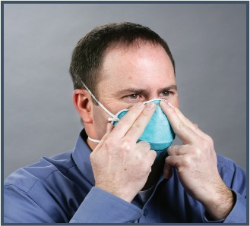
3
How to wear a P2 respirator correctly
Wash your hands before putting on the mask
Remove glasses and hats. Tie back long hair to avoid becoming tangled in the respirator straps
Position the respirator in your hands with the nose piece at your fingertips
Cup the respirator in your hand allowing the headbands to hang below your hand
Hold the respirator under your chin with the nosepiece up
While holding the respirator firmly in place on your face, pull the top strap over the head so it rests high on the back of your head
Pull the bottom strap over your head and position around the neck and below the ears
Ensure the straps remain untwisted and place your fingers at the top of the respirator and slide them down both sides of the respirator to mould the nose area to the shape of your nose
Conduct a fit check (see next slide)
4
7
8

Slide 7
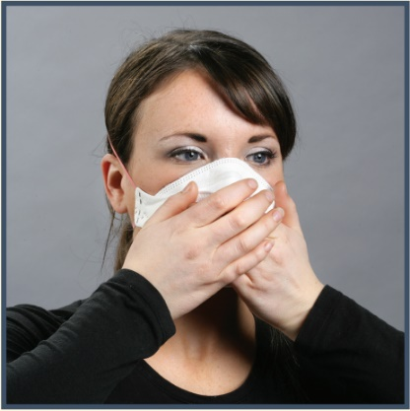
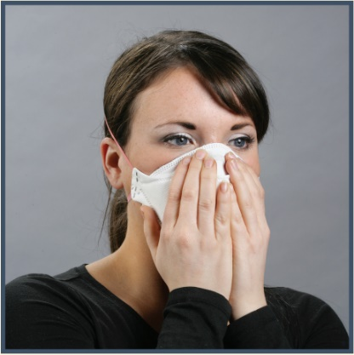
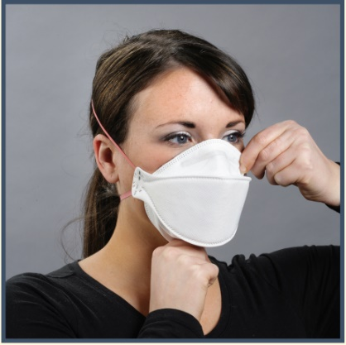
Conducting a fit check for a P2 Respirator
A fit check should be conducted at every use
Place both hands over the respirator, take a quick breath in to check whether the respirator seals tightly to the face
Place both hands completely over the respirator and exhale. If you feel leakage, there is not a proper seal
If air leaks around the nose, readjust the nosepiece as described. If air leaks at the mask edges, re-adjust the straps along the sides of your head until a proper seal is achieved
If the respirator still leaks you may need to try a different size or style of respirator.
1
2
3

Slide 8
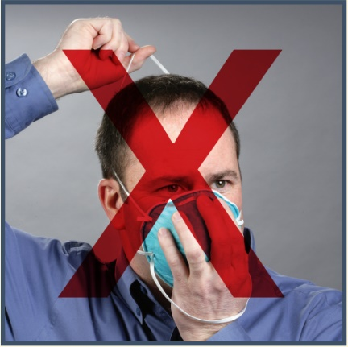
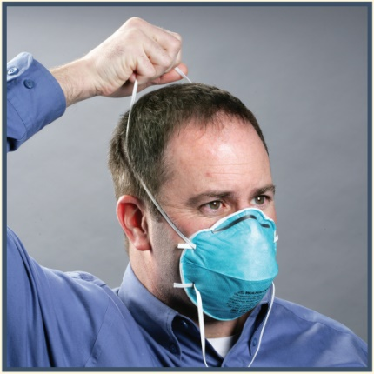
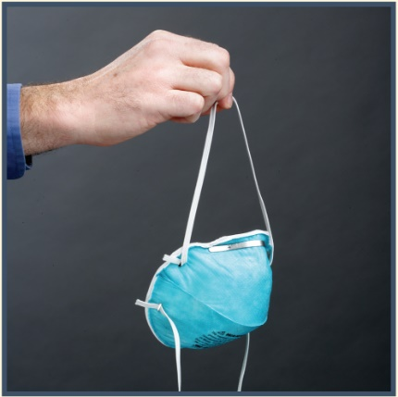
How to Remove a P2 respirator correctly
Remove bottom strap by pulling over head
Maintaining hold on the first strap, use another hand to pull the top strap over head
Avoid touching front surface of the respirator, continue to hold it by the straps
Discard the used respirator into a waste container
Wash hands
1
2
3

Slide 9
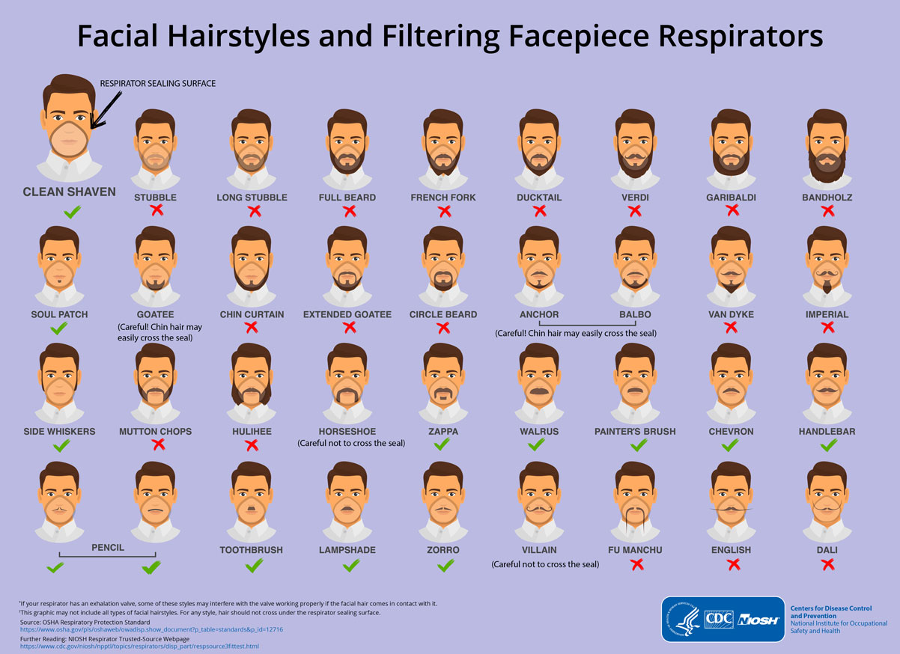
USERS must be Clean shaven
People with beards should shave before using a P2 respirator as a good seal between the respirator and the wearer’s face cannot be guaranteed if they have facial hair.​​​​​​​​​​​​​​​​​​​​​​​​​​​​​​​​​​​​
Must be clean shaven where the respirators sits.
People with even 1-2 day beard growth may not be able to achieve an adequate seal between the respirator and the wearer’s face.

Slide 10
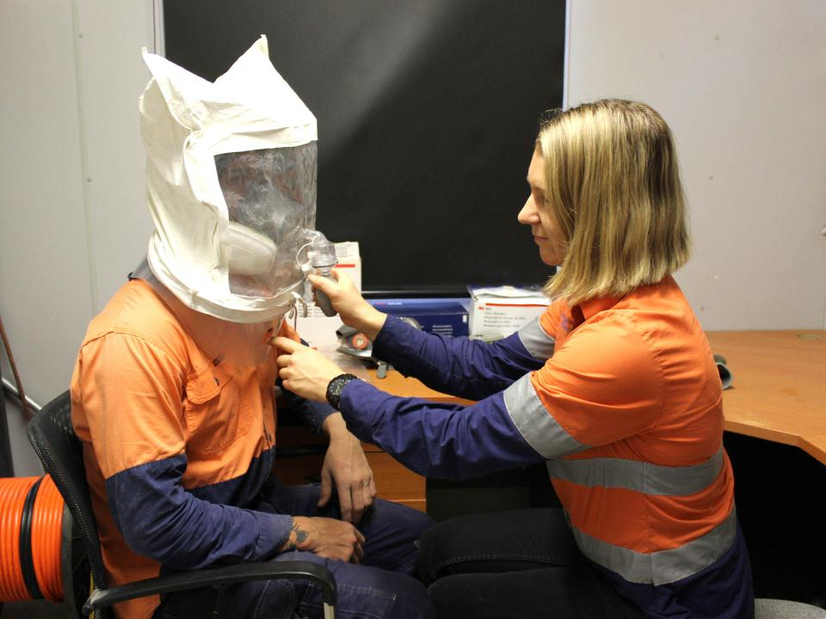
Respirator Fit Testing
Fit testing is performed before use to ensure:
Respirator fits correctly and provides adequate protection
Verifies that the respirator provides the user an adequate seal
There are two methods of fit testing that may be used:
Qualitative fit testing - uses a hood and an odour or taste solution to determine the ability of the respirator wearer to smell or taste the test agent.
Quantitative fit testing – uses specialised equipment to measure how much air leaks into the respirator.
Fit-testing can be carried out by:
a competent person (such as an occupational hygienist)
manufacturer, supplier or service provider for respirators

Slide 11
Key Takeaways
Use of respiratory protection is a mitigation that should be implemented only under specific circumstances to manage COVID-19
Respirator use is to be risk assessed and rationalised – maintaining stocks of respirators to workers who need to use them
Refer to the manufacturer’s instructions for specific advice on fitting and checking the fit of the individual brands of respirators
For a respirator to function correctly – users must be clean shaven

