Slide 1
COVID-19 Travelling for Work Guidance (AU)
COVID-19 Guidance Documentation
April 2020

Slide 2
NOTICE
The information in this pack is consistent with advice from the Australian Government and State/Territory Governments as at 03 April 2020.
Government advice and regulations regarding COVID-19 are changing often, sometimes within the course of a day.
If advice from these agencies in relation to this issue changes, or a relevant Government mandates further action in relation to the issues dealt with in this pack, Ventia will update the content to reflect that changed advice and/or mandated action.
Please continue to refer to theVine to ensure you have the most up to date information packs.

Slide 3
disclaimer
The following material has been developed by Ventia, one of TfNSW’s major contractors to support Ventia leaders in managing COVID-19 risks in their workplaces. The material has been developed taking account of advice from World Health Organization, Australian Government Department of Health, US Centre for Disease Control, and requirements of Australian and State Governments at the date noted in the packs.
Ventia has agreed to make the material available to TfNSW to inform and assist TfNSW in relation to the management of COVID-19 risks. Please note, however, that it has been developed to support Ventia’s specific context and may not be relevant to other organisations or in all TfNSW contexts. The reader will need to exercise judgement about the appropriateness of the Ventia materials and their relevance to the reader’s own requirements. Please note also that Government requirements regarding COVID-19 may continue to change, and the materials will need to be assessed against current government requirements.

Slide 4
How Do Travel & Border Restrictions Work to prevent the spread of Covid-19?
Travel and border restrictions are currently being introduced to varying degrees across Australia with advice and restrictions are varying from state to state.
Travel and border restrictions is one way to minimise the movement of people and confine the spread of viruses, such as COVID-19.
All Australians are required to stay home other than for very limited and specific reasons. This includes a requirement to work from home wherever possible. However, many essential work tasks and activities cannot be done from home.
Where unable to work from home – travel to the extent reasonably necessary to perform work is allowed.
Some states and territories have additional requirements for those entering the state/territory or specific communities within and further restrictions may apply.
A guidance on Border and Movement restrictions has also been developed and should be reviewed when planning works.

Slide 5
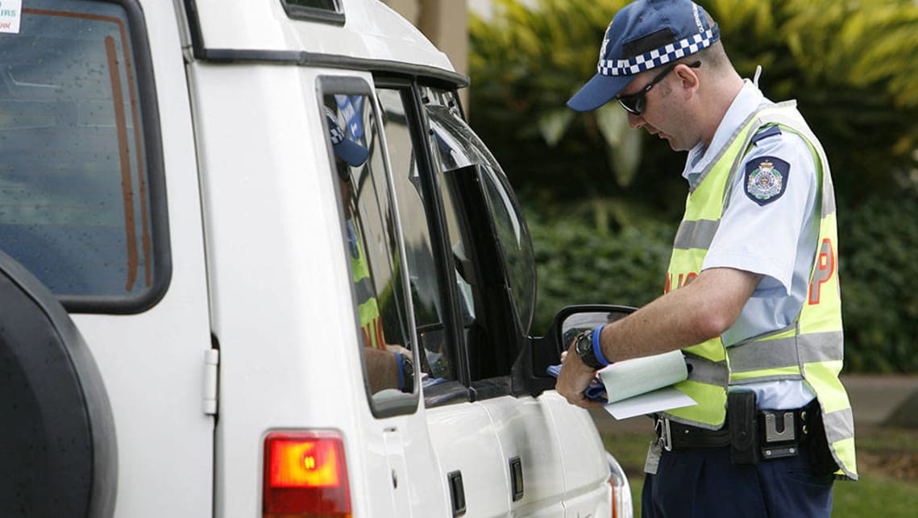
Essential Services Identification
Many work tasks Ventia performs require movement, either regularly on the road from work site to work site or even to and from work or office.
With movements of people being managed to essential tasks (such as work). We can assist by ensuring documentation for our works.
All workers and work crews should ensure they have with them:
Essential Activity Services Letter – including carry if travelling to work site / office
Appropriate form of ID
For certain locations, such as high-risk communities or movement across regions/state/territory borders, additional authorisations may be necessary.
Work with your Supervisor or SHEQ Representative to understand in advance where these may be required.

Slide 6
Working within vehicles
Plan work tasks with your Supervisor or Manager to wherever possible, limit vehicles to no more than 2 persons within the same vehicle
Within dual-cab utes or vehicles, the passenger should ride in the passenger side rear seat to maximise separation
Open vehicle windows or vehicle air-conditioning is set to fresh air to increase ventilation within the vehicle
Regularly clean and disinfect high touch vehicle surfaces (steering wheel, handles) in accordance with cleaning guidance materials
Ensure access to hand hygiene products, including soap and water or alcohol-based (>60% alcohol) sanitisers
Ensure our SHEWMS, JSEA or Risk Assessments and other works documentation is current and reflects planned work tasks. If the work tasks requires variations to the above requirements, consult with our Supervisor/Manager to update our risk documentation

Slide 7
Staying Overnight in Hotels
Whilst most tasks Ventia conducts allow us to return home each night, where this is not possible
Before booking, ask the hotel about the COVID-19 procedures they might have in place
Check the room, prior to settling in. If the room does not appear to be cleaned down, report to the hotel staff
Do not socialise or congregate with colleagues, maintain the room as a personal environment during your stay
Clean ‘high-touch’ surfaces such as door handles daily with appropriate cleaning wipes or disinfectants in accordance with their instructions of use
Wash your hands with soap and water each time you enter your room
Consider bringing your own pillow and / or bedding
Continue to follow government health advice and Ventia COVID-19 guidance materials, such as COVID-19 Physical Distancing Guidance

Slide 8
Key Takeaways
Travel and border restrictions is a method for minimising movement of people to reduce the spread of COVID-19 across the community
Restrictions on movement vary across regions/states/territories – ensure we plan ahead and are aware of requirements in advance
Existing control measures, such as physical distancing measures, need to be applied, wherever practical, even as we conduct essential works

