Slide 1
Vehicle cleaning & sanitisation
March 2020

Slide 2
NOTICE
The information in this pack is consistent with advice from the Australian Government and New Zealand Government as at 25 March 2020.
However, Government advice and regulations regarding COVID-19 are changing often, sometimes within the course of a day.
If advice from these agencies in relation to this issue changes, or a relevant Government mandates further action in relation to the issues dealt with in this pack, Ventia will update the content to reflect that changed advice and/or mandated action.
Please continue to refer to theVine to ensure you have the most up to date information packs.

Slide 3
disclaimer
The following material has been developed by Ventia, one of TfNSW’s major contractors to support Ventia leaders in managing COVID-19 risks in their workplaces. The material has been developed taking account of advice from World Health Organization, Australian Government Department of Health, US Centre for Disease Control, and requirements of Australian and State Governments at the date noted in the packs.
Ventia has agreed to make the material available to TfNSW to inform and assist TfNSW in relation to the management of COVID-19 risks. Please note, however, that it has been developed to support Ventia’s specific context and may not be relevant to other organisations or in all TfNSW contexts. The reader will need to exercise judgement about the appropriateness of the Ventia materials and their relevance to the reader’s own requirements. Please note also that Government requirements regarding COVID-19 may continue to change, and the materials will need to be assessed against current government requirements.

Slide 4
Overview
One of the ways viruses (including coronaviruses such as COVID-19) can be spread is through touching contaminated objects or surfaces then touching your face or mouth.
For many workers the vehicle is their workplace and general cleaning protocols need to be implemented to reduce the risk of infection.
Vehicles of workers with potential or confirmed COVID-19 require more thorough cleaning and sanitisation

Slide 5
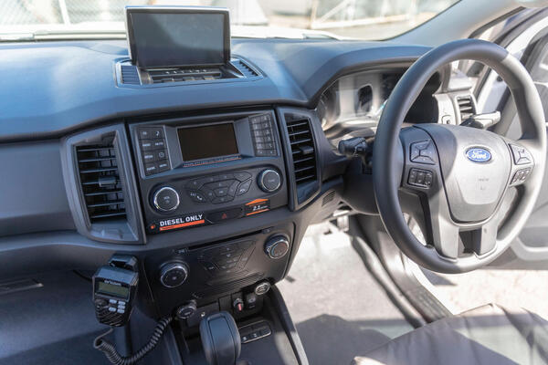
General cleaning
Ventia vehicles should be cleaned daily using common domestic alcohol based wet wipes or sprays (e.g. Glen 20 is suitable) with a specific focus on high contact areas such as:
seats and seatbelts
dashboard
steering column levers/stalks (indicator and light switches)
gear lever/dial
steering wheel
door handles
Workers completing general cleaning activities should wear disposal gloves and wash their hands with soap and water (or alcohol-based hand sanitiser if soap and water isn’t available) before and after wearing gloves.

Slide 6
Thorough cleaning and sanitisation
For vehicles located at a Ventia company depot or office
Vehicle cleaning and sanitisation may be completed by facility cleaning personnel if they have the required cleaning products and PPE.
Effective cleaning products are common disinfectants including sodium hypochlorite 0.5% (bleach), 70% ethanol (alcohol based cleaning products) and ammonium based cleaners.
Minimum PPE requirements are disposable gloves, glasses and surgical face mask.
Where possible, additional PPE consisting of a Tyvek suit or apron and a P2 face mask should be worn.
If required cleaning products and PPE are not available, professional vehicle cleaners should be used
Obtain expenditure approval from your Manager prior to engaging the professional cleaners

Slide 7
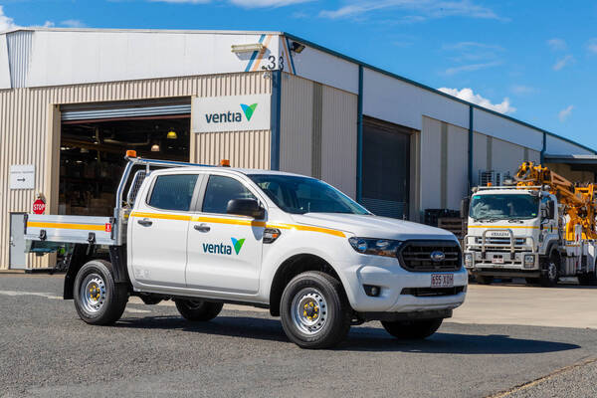
Thorough cleaning and sanitisation
For vehicles located remote from a Ventia depot or office
Contact your regional plant team representative or Fleet Leasing Company in accordance with the Undertake Planned Maintenance for Plant & Equipment Business Process
Obtain prior approval for professional cleaning costs from the relevant Manager
Ensure the service provider is aware of the potential COVID-19 contamination

