Slide 1
COVID-19 Hand Hygiene Guidance
COVID-19 Guidance Documentation
March 2020

Slide 2
NOTICE
The information in this pack is consistent with advice from World Health Organization, Australian Government Department of Health, Ministry of Health New Zealand and US Centre for Disease Control, and requirements of Australian and State Governments, as at 25 March 2020.
However, Government advice and regulations regarding COVID-19 are changing often, sometimes within the course of a day.
If advice from these agencies in relation to this issue changes, or a relevant Government mandates further action in relation to the issues dealt with in this pack, Ventia will update the content to reflect that changed advice and/or mandated action.
Please continue to refer to theVine to ensure you have the most up to date information packs

Slide 3
disclaimer
The following material has been developed by Ventia, one of TfNSW’s major contractors to support Ventia leaders in managing COVID-19 risks in their workplaces. The material has been developed taking account of advice from World Health Organization, Australian Government Department of Health, US Centre for Disease Control, and requirements of Australian and State Governments at the date noted in the packs.
Ventia has agreed to make the material available to TfNSW to inform and assist TfNSW in relation to the management of COVID-19 risks. Please note, however, that it has been developed to support Ventia’s specific context and may not be relevant to other organisations or in all TfNSW contexts. The reader will need to exercise judgement about the appropriateness of the Ventia materials and their relevance to the reader’s own requirements. Please note also that Government requirements regarding COVID-19 may continue to change, and the materials will need to be assessed against current government requirements.

Slide 4
COVID-19 Hand Hygiene
Practising good hand and sneeze/cough hygiene is an important defence for mitigating the risk of COVID-19.
This includes recommendations to:
Wash your hands frequently with soap and water - especially before and after eating, after going to the toilet, after blowing your nose, coughing or sneezing.
Wash your hands often with soap and water for at least 20 seconds. Use hand sanitiser with at least 60% alcohol if soap and water are not available.
Cover your mouth and nose with a tissue when you cough or sneeze or use the inside of your elbow. Throw used tissues in the rubbish and immediately wash hands with soap and water for at least 20 seconds. If soap and water are not available, use hand sanitiser containing at least 60% alcohol.
This information is consistent with advice from World Health Organization, Australian Government Department of Health, Ministry of Health New Zealand and US Centre for Disease Control.

Slide 5
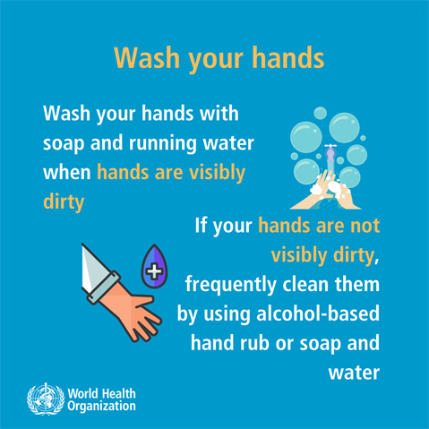
How Does Hand Washing Work against Covid-19?
COVID-19 and many other viruses have an outer coating, called an envelope, which helps the virus latch onto and invade new cells. For COVID-19, this envelope is made up of fatty substances
Soap dismantles the virus envelope (preferred)
Soap molecules breaks up the virus envelope and disables the virus when placed in close proximity due to the fatty substances in both
Alcohol sanitisers change the virus envelope
Alcohol-based (>60%) hand sanitisers target the vulnerable viral envelopes by changing the envelope’s chemical properties, making it less stable and more susceptible to the outside world
Both methods help to disrupt the COVID-19 virus

Slide 6
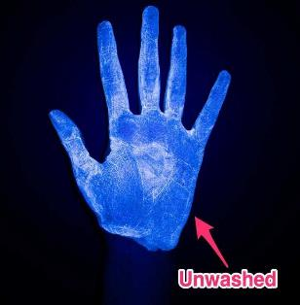
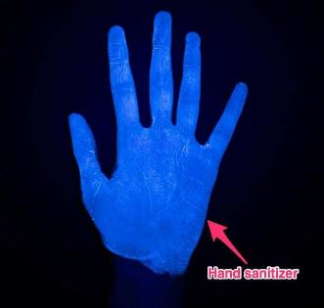
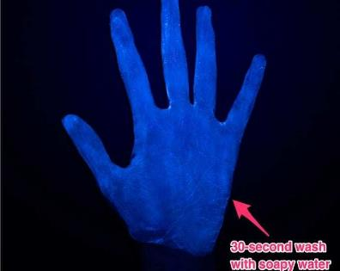
Clean Your Hands Often
Wash your hands often with soap and water for at least 20 seconds especially after you have been in a public place, or after blowing your nose, coughing, or sneezing.
If soap and water are not readily available, use a hand sanitizer that contains at least 60% alcohol. Cover all surfaces of your hands and rub them together until they feel dry.
Avoid touching your eyes, nose, and mouth with unwashed hands.
Reference: https://www.weforum.org/agenda/2020/03/soap-hand-sanitizer-germs-coronavirus

Slide 7
Handwashing Instructional Video
Press Play to Start

Slide 8
Correct Process How to Handwash (20+ Seconds)

Slide 9
Correct Process How to Handwash (20+ Seconds)

Slide 10
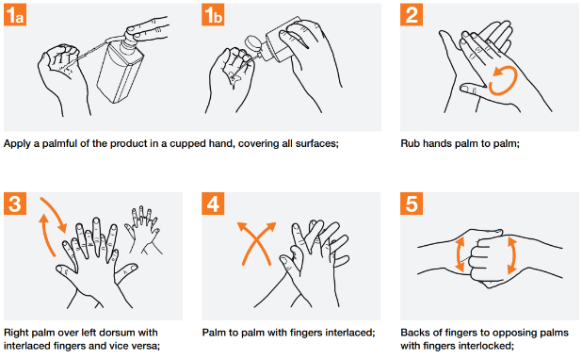
Correct Use of Hand Sanitiser
Washing hands with soap and water is the best way to get rid of germs in most situations.
If soap and water are not readily available, you can use an alcohol-based hand sanitiser that contains at least 60% alcohol.
You can tell if the sanitiser contains at least 60% alcohol by looking at the product label.
How to use hand sanitiser
Apply the gel product to the palm of one hand (read the label to learn the correct amount).
Rub your hands together.
Rub the gel over all the surfaces of your hands and fingers until your hands are dry. This should take around 20 seconds.

Slide 11
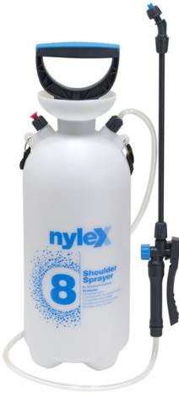
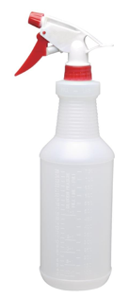
Hand Hygiene in the field
Recognising that access to hand washing facilities may be more restricted in the field and that access to sanitiser is becoming increasingly limited due to stock.
Project alternatives that could be available for sites or vehicles include:
use of soap dispenser or spray bottles with a soap solution
use of spray bottle or garden sprayer filled with water
single use disposable hand towels for drying hands
bag for disposal of consumables
Individuals to apply correct hand washing techniques.
Use of disposable gloves is an important alternative in some situations.

Slide 12
Key Takeaways
Hand hygiene is an important defence to mitigate the spread of COVID-19
Soap and water is the best method to clean your hands
Use hand sanitiser with at least 60% alcohol if soap and water are not available
Consider access to hand hygiene in all our processes – including field works

