Slide 1
Example VMP (vehicle movement plan) for work site with simple access arrangements – TCAWS VMP 03
Disclaimer
While care and diligence has been taken to produce the checklists, templates, and example documents (Documents), no responsibility is taken, or warranty made with respect to the accuracy or correctness of the Documents. Transport for NSW expressly disclaim all liability for any omissions, errors, inaccuracy, or incompleteness of any of the Documents and the consequences upon reliance of the Documents.
The Documents are provided for general information purposes only. While every attempt has been made to align these documents with the Traffic control at work sites (TCAWS) Technical Manual, the Documents provided are only examples. The use of these Documents may not fulfill all the relevant requirements in the latest release of the TCAWS Technical Manual. It is the obligation of the user to ensure that appropriate modifications are made to meet the requirements of the TCAWS Technical Manual.
Disclaimer updated on 20 October 2023, 9:00am
transport.nsw.gov.au

Slide 2
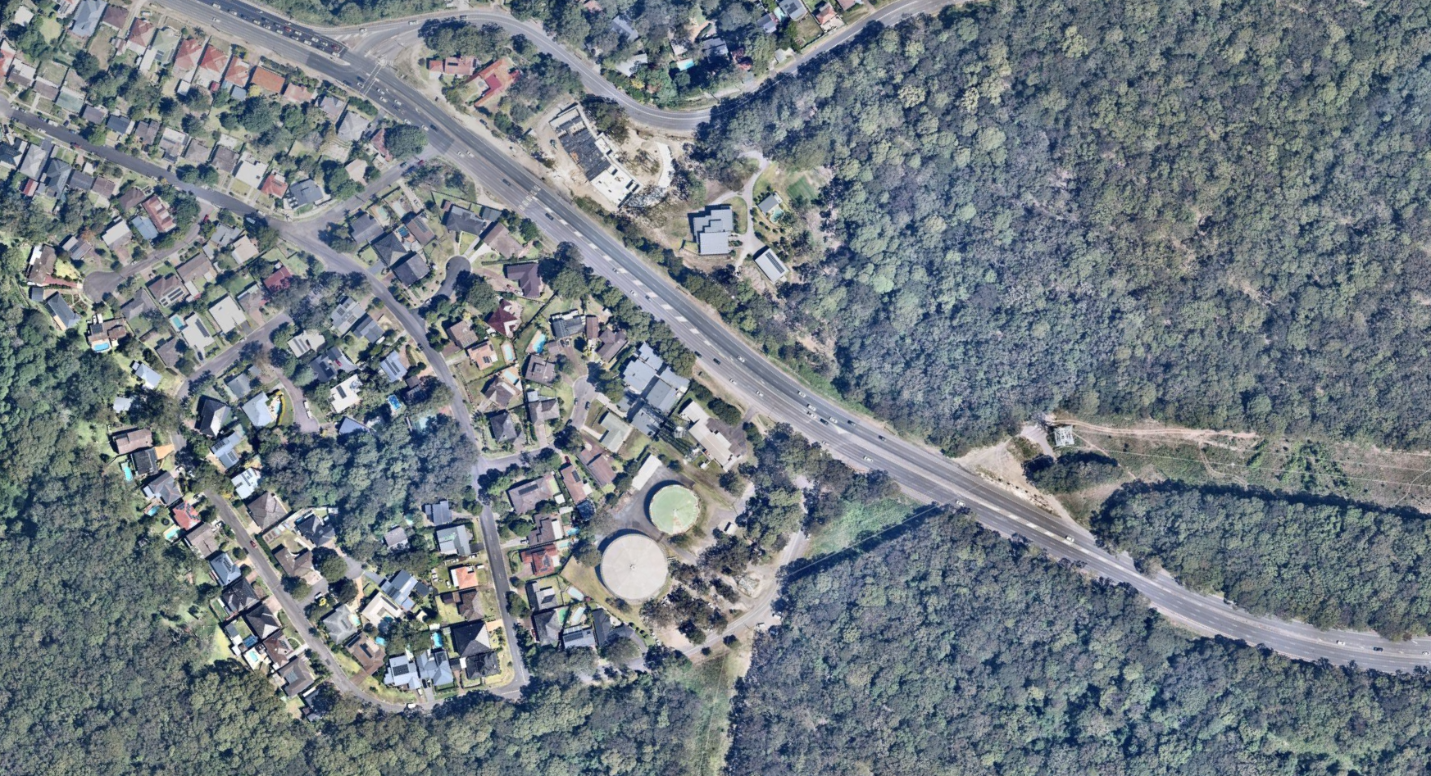









EXAMPLE Vehicle Movement Plan (VMP)
 |  |  |  |  |  |  |  | LEGEND
 |  |  |  |  |  |  |  |  | Vehicle Movement
 |  |  |  |  |  |  |  |  | Pedestrian path
 |  |  |  |  |  |  |  |  | Traffic cones
 |  |  |  |  |  |  |  |  | Work Area
 |  |  |  |  |  |  |  |  | Traffic Controller/ Spotter
 |  |  |  |  |  |  |  | NOTES
 |  |  |  |  |  |  |  | SITE CONTACT: UHF CHANNEL 16 or Phone: 0499 999 999 All vehicles are to contact the traffic controller and wait for instructions before entering or exiting the site Left IN and left OUT access only Drivers entering the site are to ensure that adequate warning is given before pulling off the road No turning across traffic lanes to enter the work site Always give way to traffic on the Pacific Highway when exiting the site All vehicles accessing the site to have rotating/flashing amber light(s) switched on Pedestrians/cyclists shall be given right of way by all vehicles when entering or exiting All traffic movements are to be in accordance with NSW road rules
 | NAME | PWZTMP NO. | DATE | SIGNATURE
DRAWN | JOHN SMITH | TCT0009998 | 23/04/2023 |  |  | PROJECT | TEST PROJECT ADAMSTOWN HEIGHTS – STAGE 1A
APPROVED | JANE JONES | TCT0009999 | 25/04/2023 | J. Jones |  | LOCATION | 299 PACIFIC HIGHWAY, ADAMSTOWN (500m south of Scenic Drive)
N
Pacific Highway
Trucks Crossing/Entering
Work vehicle
Left in / left out access only
Worker / Surveyor
Work site

